Slide 1
Getting Started SAM.gov, LOGIN.gov, & FEMAGO

Slide 2
Agency Mission
The Department's mission is to provide military and emergency management capabilities to citizens of Arizona and the Nation

Slide 3
SAM.gov
System for Award Management

Slide 4
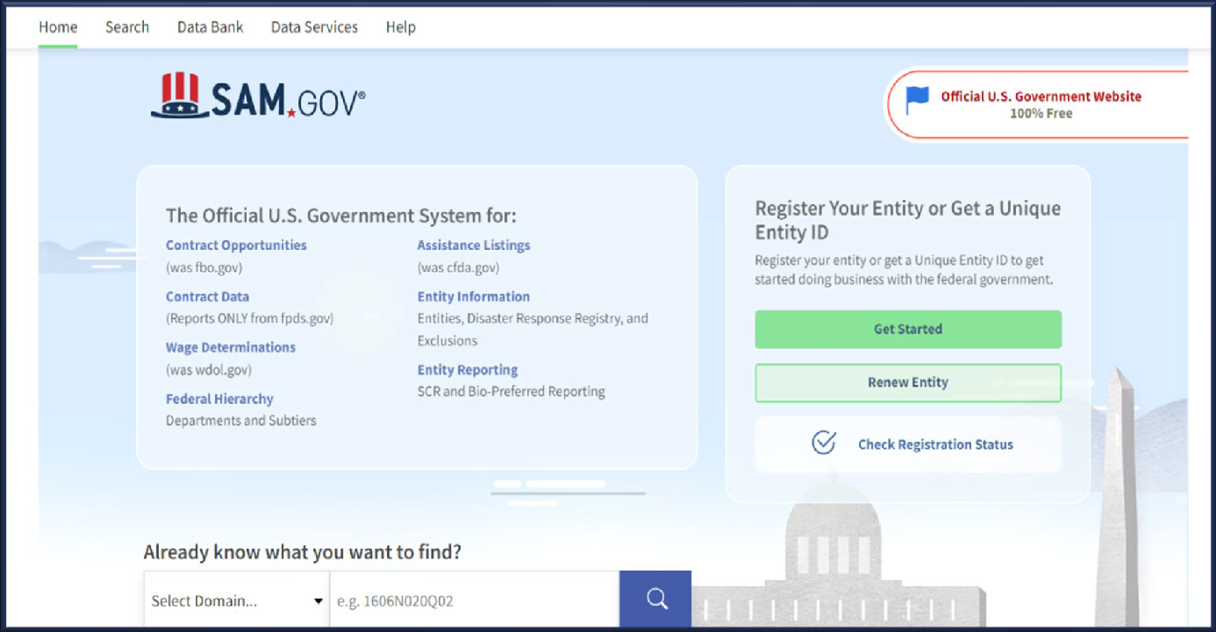
What is SAM.gov?
Entities use SAM.gov to:
Do business with the U.S government
Update, renew, status of, & search for entity registration
Active account
UEI (unique entity identifier)is assigned

Slide 5
SAM.gov Account Set Up
Step 1:
Reach out to your finance team/department
Ask: “Does our entity have a UEI?”.
Step 1a: If the answer is “YES”
Skip to LOGIN.gov access
Step 1b: If the answer is “NO”
Continue to registration of Entity
What you need to register
Your Ebiz Point of contact (POC)
Entity name, phone number, and email address

Slide 6
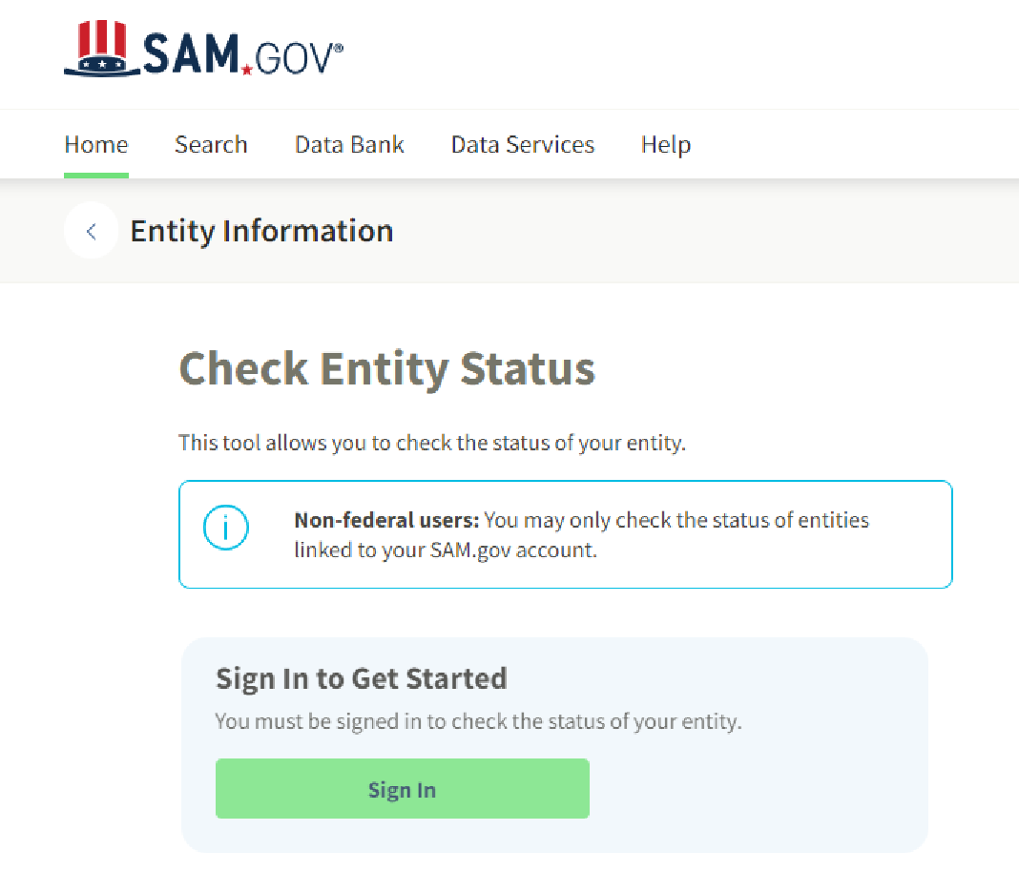
SAM.gov Account Reminders
Important reminders:
Organization must register on SAM.gov
Can take up to 45 Days, register now
SAM.gov account must remain active
SAM.gov HELP – Federal Service Desk

Slide 7
Login.gov

Slide 8
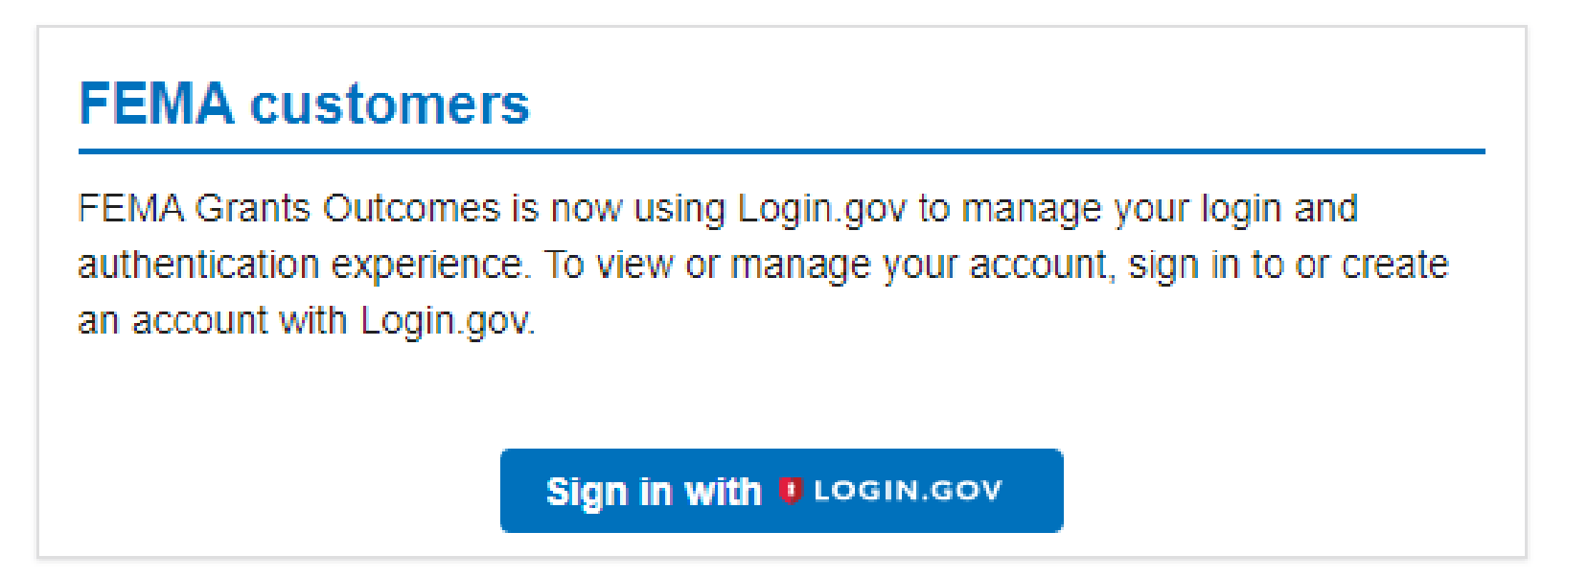
Sign-in with Login.gov
STEP 1:
Navigate to go.fema.gov

Slide 9
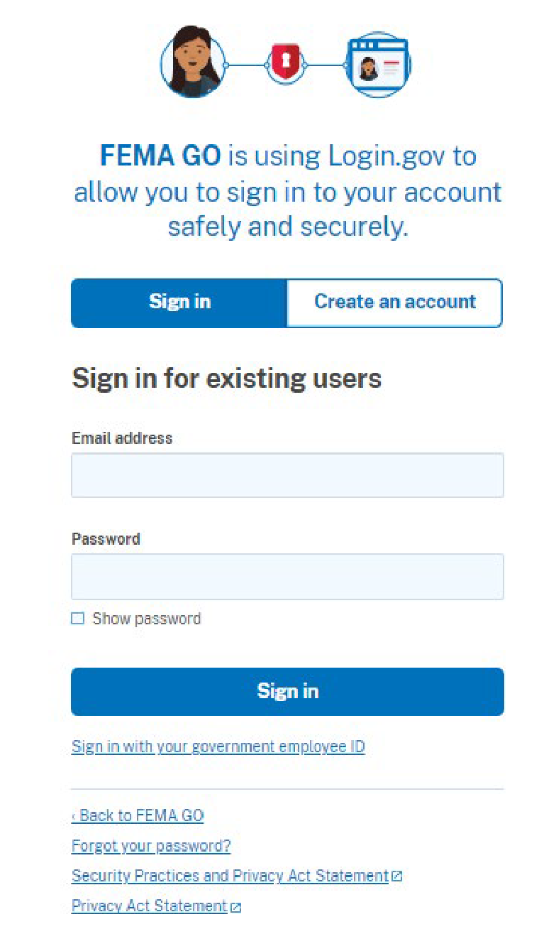
Sign-in with Login.gov
STEP 2:
A) If you already have Login.gov
Sign in
B) If do not have a Login.gov
Create one

Slide 10
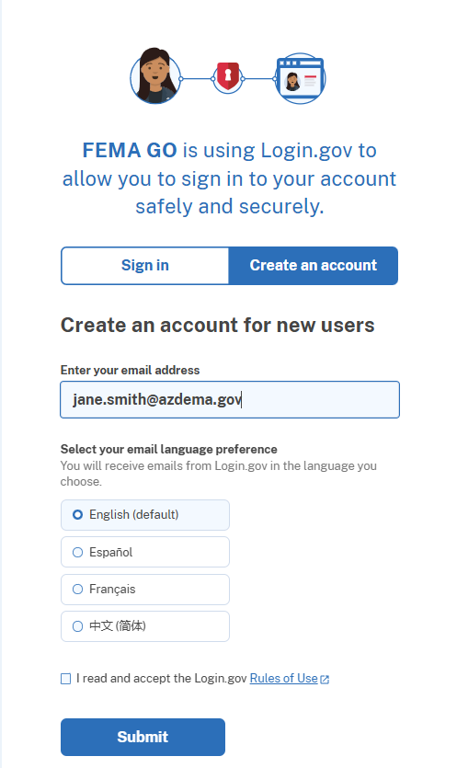
Sign-in with Login.gov
STEP 3:
Create new user account

Slide 11
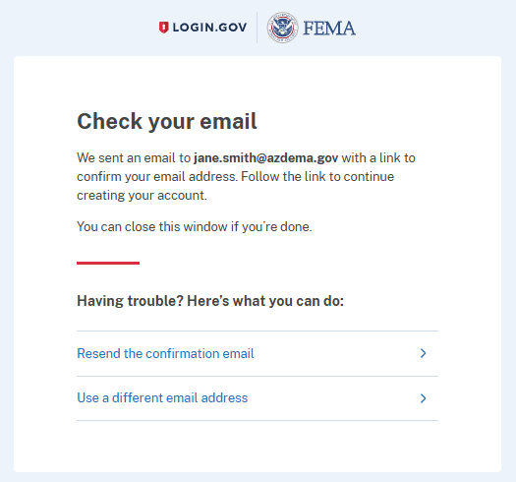
Sign-in with Login.gov
STEP 4:
Check your email
Registration link
Authenticate
No email?
Check Spam and Junk Folders

Slide 12
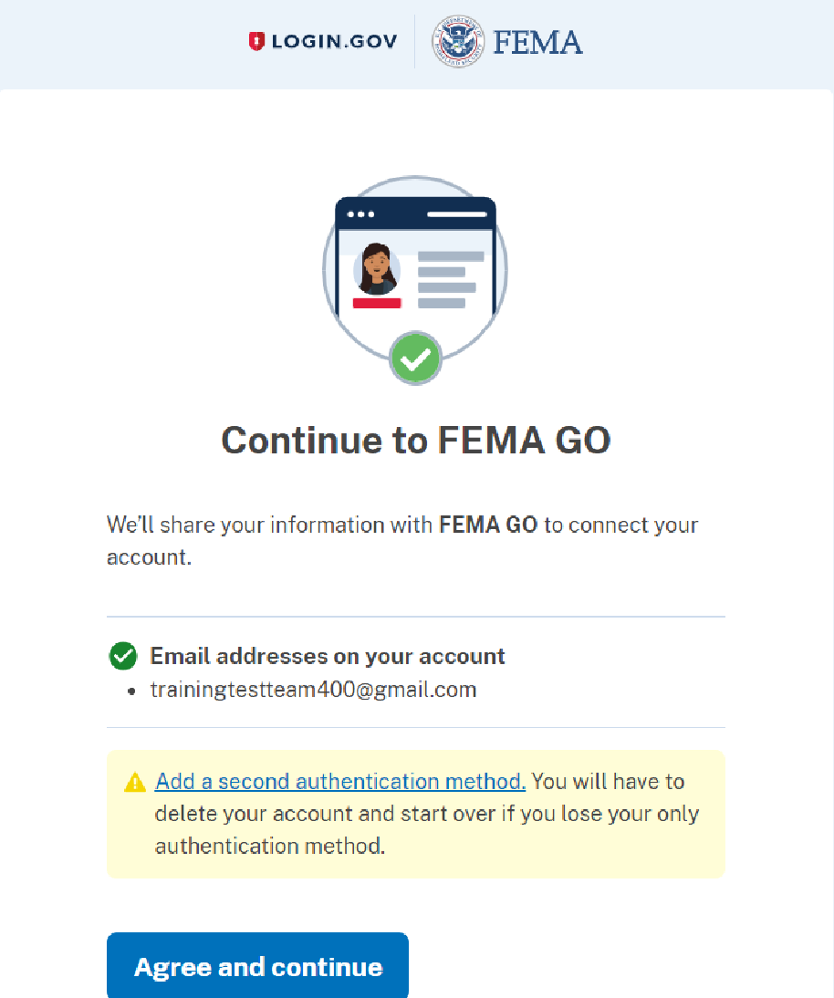
Sign-in with Login.gov
STEP 5:
Select Agree and continue
You will be redirected to FEMA GO

Slide 13
FEMA GO

Slide 14
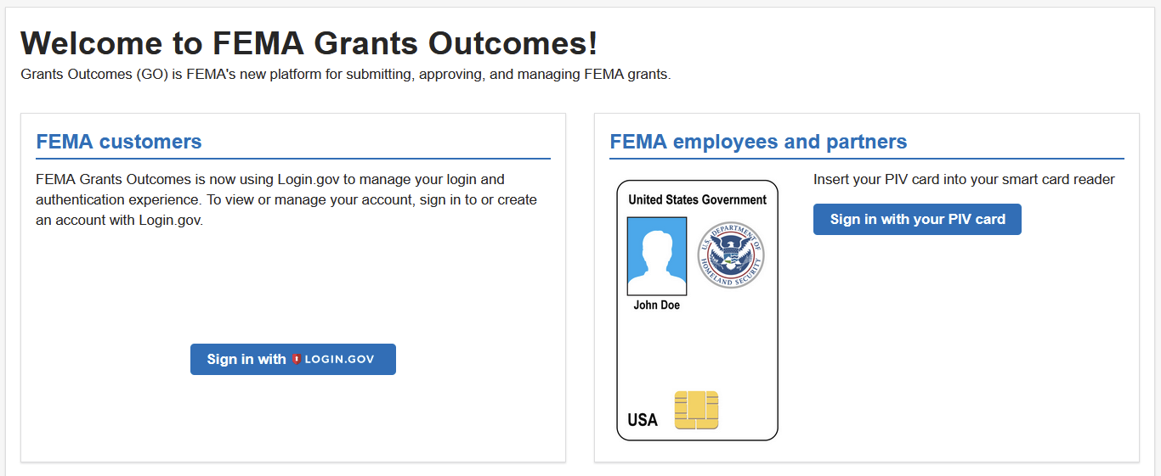
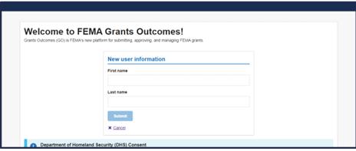
Welcome to FEMA GO

Slide 15
FEMAGO Account Set Up
Step 1:
Search by UEI to find your POC
Step 2:
Reach out to POC
Step 3:
POC will locate you with your email
Step 4:
POC will add you to organization

Slide 16
Access to your Organization
Step 5: Navigate to your profile
Click to view Your profile

Slide 17
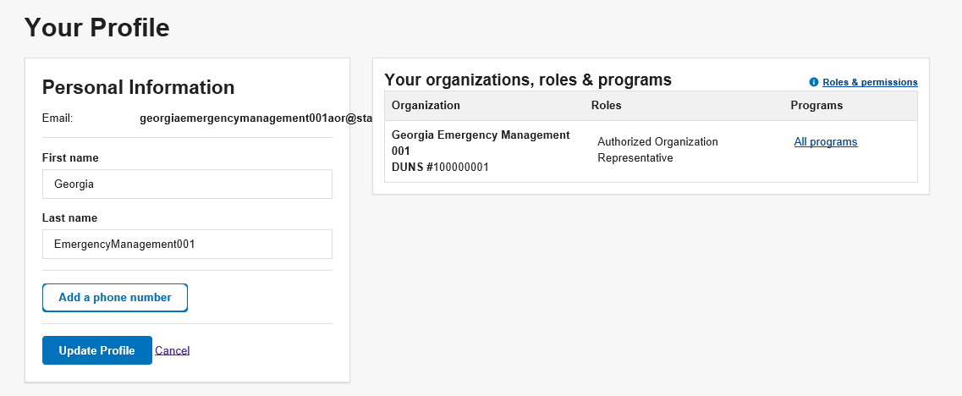
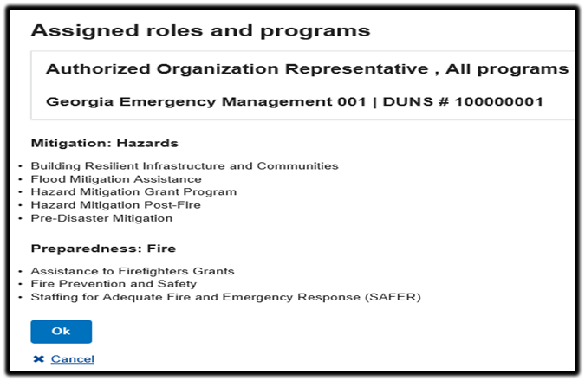
Access to your Organization
Step 6: Check your access

Slide 18
Roles and Permissions

Slide 19
Questions
Destiny Colorado State Hazard Mitigation Officer Office: (602) 464-6499 Mitigation@azdema.gov

Slide 20
Thank you!
For more information about DEMA, visit dema.az.gov.

