Slide 1
BRIC/FMA Subapplication Walkthrough

Slide 2
Agency Mission
The Department's mission is to provide military and emergency management capabilities to citizens of Arizona and the Nation

Slide 3
Start a Subapplication
Once you are logged in you will be directed to the Welcome Screen
Select Building Resilient Infrastructure and Communities (BRIC) or Flood Mitigation Assistance Grant Program (FMA)
There is only one difference between BRIC and FMA
FMA subapplication must benefit at least one building/structure that is insured by the National Flood Insurance Program (NFIP)
Select Start subapplication and a new window will open

Slide 4
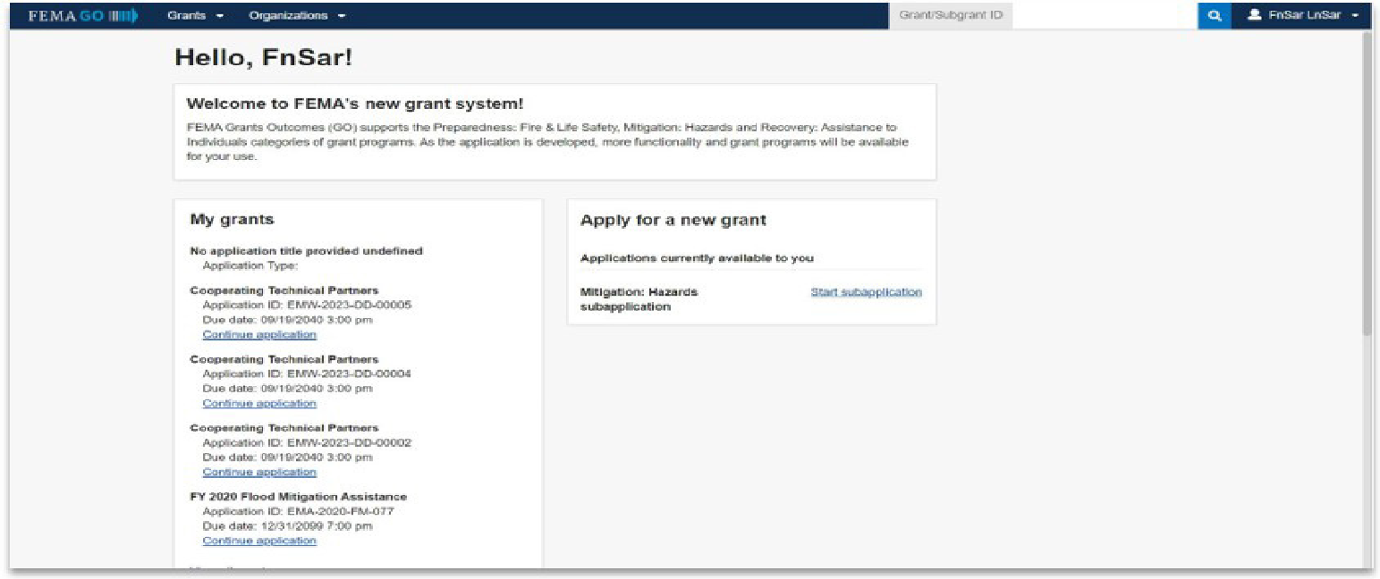
Start a Subapplication

Slide 5
Start a Subapplication Process
Select Start new subapplication or copy existing one
Select the organization you are applying for
Select the organization you are applying to
Create a subapplication title
Example: FY2024 BRIC - City of Tombstone Flood Elevation of 3 Homes

Slide 6
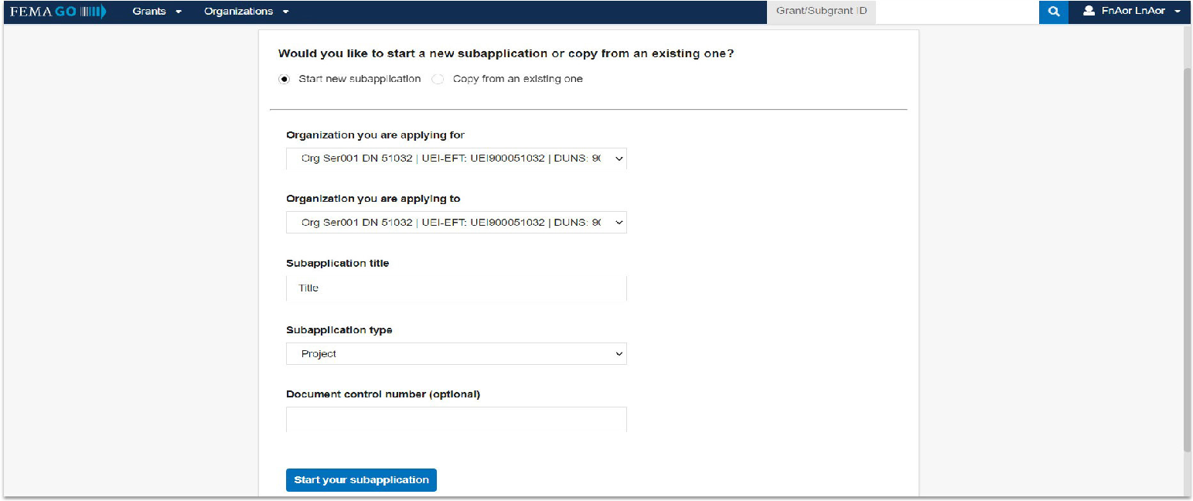
Start a Subapplication Process

Slide 7
Start a Subapplication Process
Select a Subapplication type
Plan - a subapplication to develop or update a hazard mitigation plan
Project - a subapplication for any mitigation activity to reduce risk, including education and outreach
Project Scoping - a subapplication to assist with the critical elements of developing other project subapplications (developing mitigation strategies, obtaining data, EHP compliance concerns, and other activities)

Slide 8
Subapplication Sections
Subapplication Information Budget
Contact Information Evaluation
Community Comments and Attachments
Scope of Work Assurances and Certifications
Schedule Review & Submit

Slide 9
Subapplication Information
Section 1: Subapplicant Information
Select Submission type
Select Subapplicant type
Answer all questions
Select Continue

Slide 10
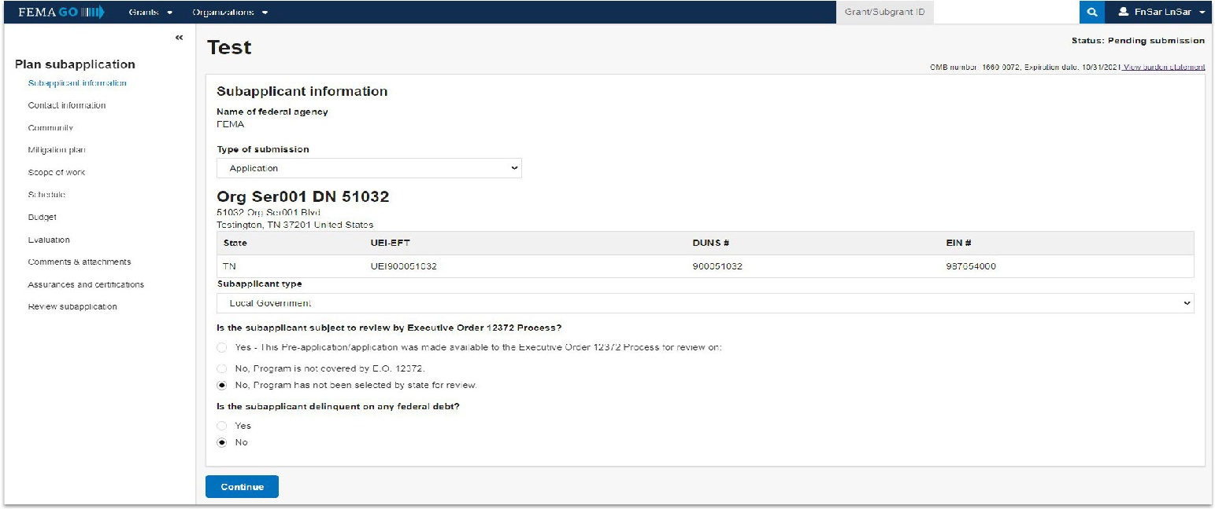
Subapplication Information

Slide 11
Contact Information
Section 2: Contact Information
Select Add a SAR (Subrecipient Authorized Representative)
Select Add a point of contact Once this button is selected, you will
need to select an individual and add all of their information
Select Continue

Slide 12
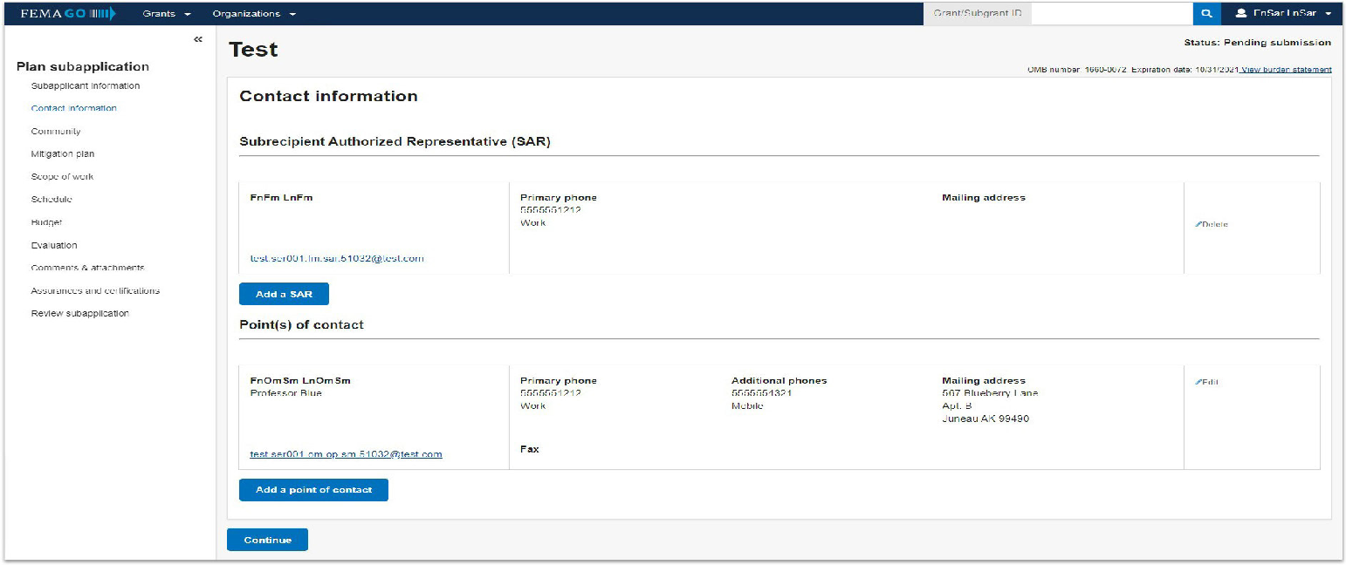
Contact Information

Slide 13
Community
Section 3: Community
To identify communities that will benefit from this mitigation
activity, select Find communities.
From the automated list of communities that appears, select the applicable communities.
Select Continue

Slide 14
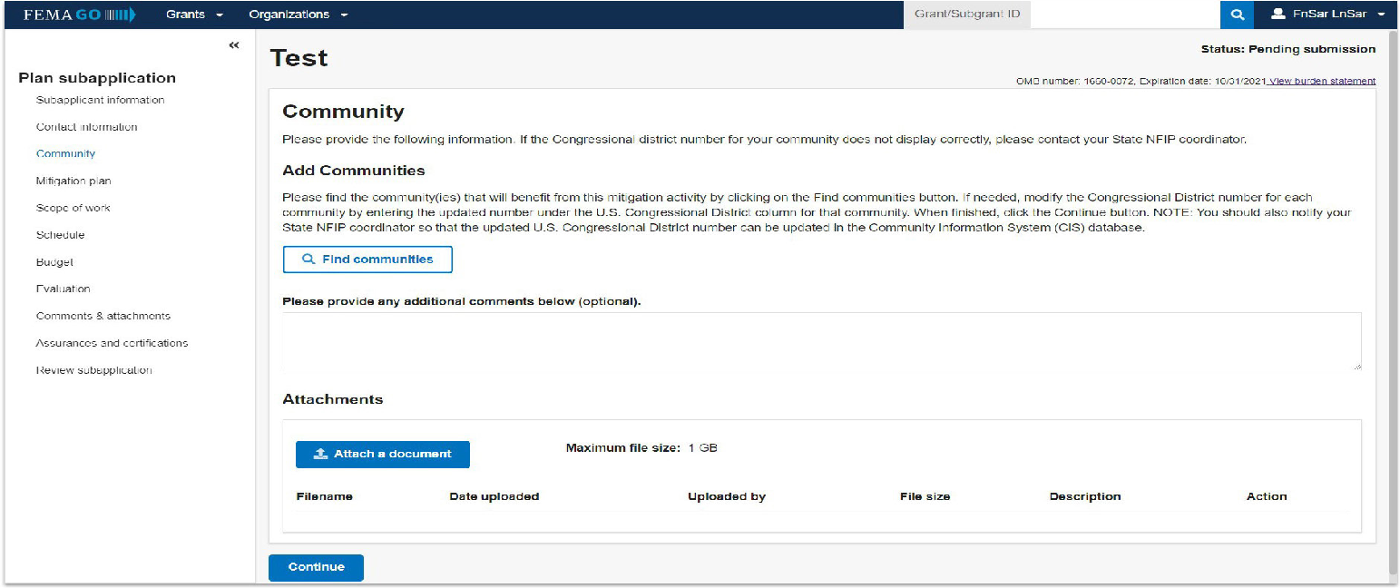
Community

Slide 15
Scope of Work
Section 4: Scope of Work
Input a Subapplication title
Identify and add Activity types and sub-activity types
Add a Geographic areas description
Provide Hazard source and descriptions
Add any applicable attachments
Select Continue

Slide 16
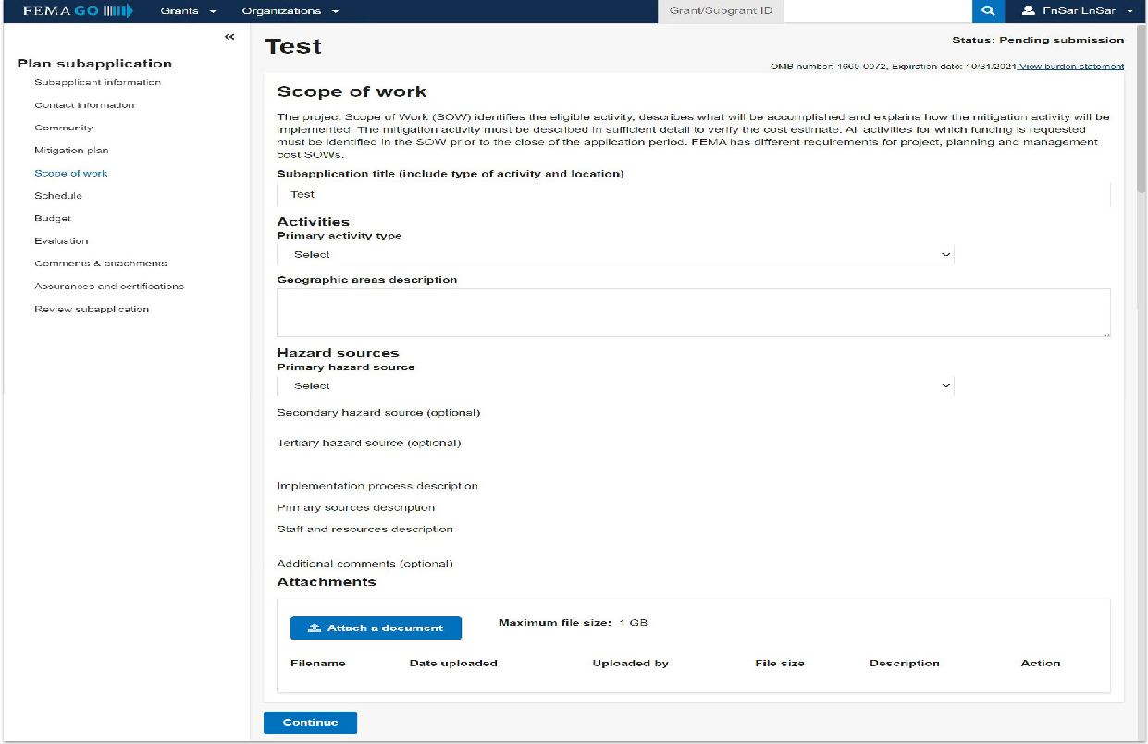
Scope of Work

Slide 17
Schedule
Section 5: Schedule
Click Add a task for each activity to add a task name, task description, start month, and task duration.
You can enter multiple tasks, however, there must be at least one.
Add overall estimated duration for your proposed activities
Add proposed project start and end dates
Select Continue

Slide 18
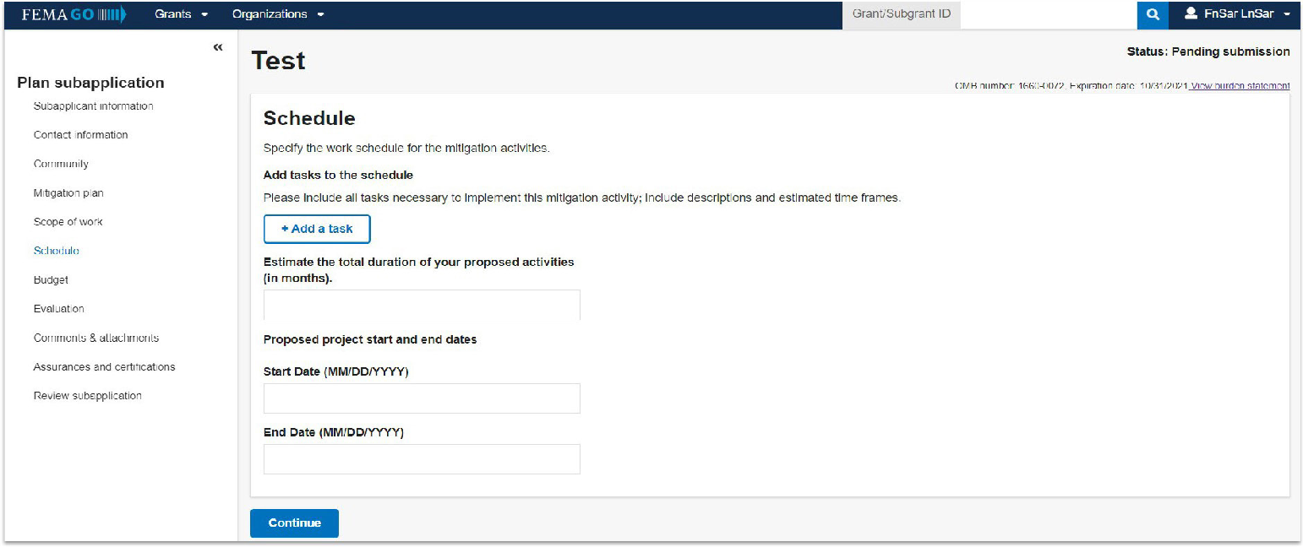
Schedule

Slide 19
Budget
Section 6: Budget
Click Add cost type to add a new cost type. This will create an additional section where you must select Add an item.
You must add at least 1 cost item greater than $0
Review and adjust your cost shares and funding sources as needed
Include any comments and attach any documentation
Select Continue

Slide 20
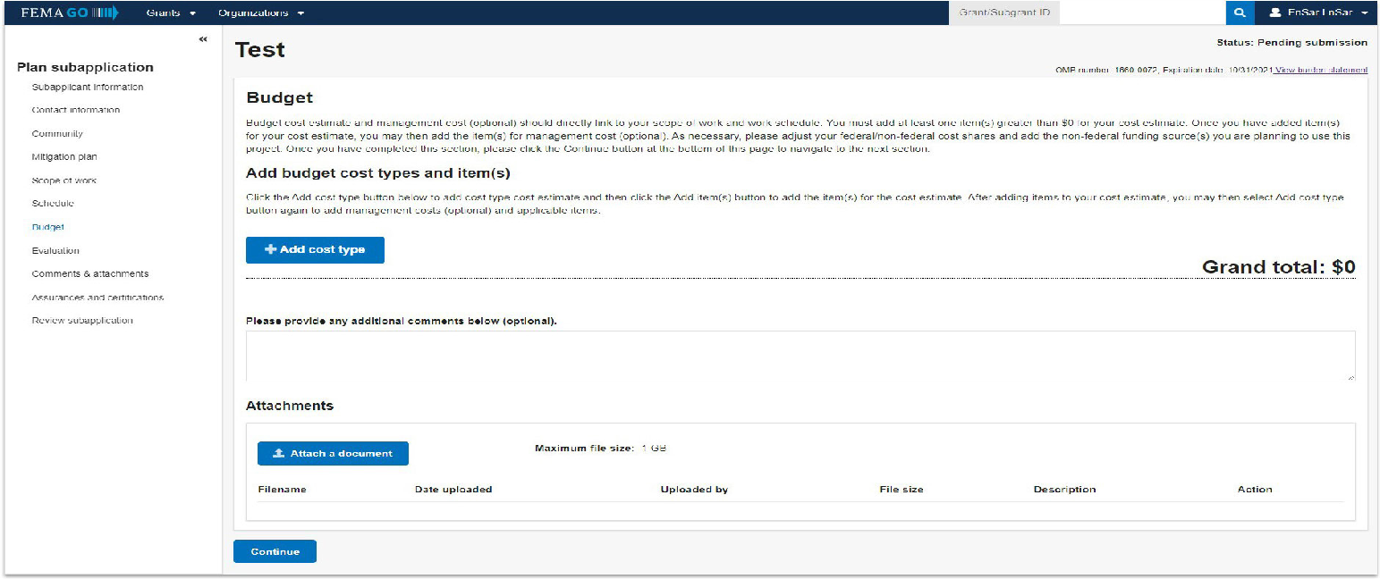
Budget

Slide 21
Evaluation
Section 7: Evaluation
Indicate yes or no and provide written responses
Add attachments as needed
Select Continue

Slide 22
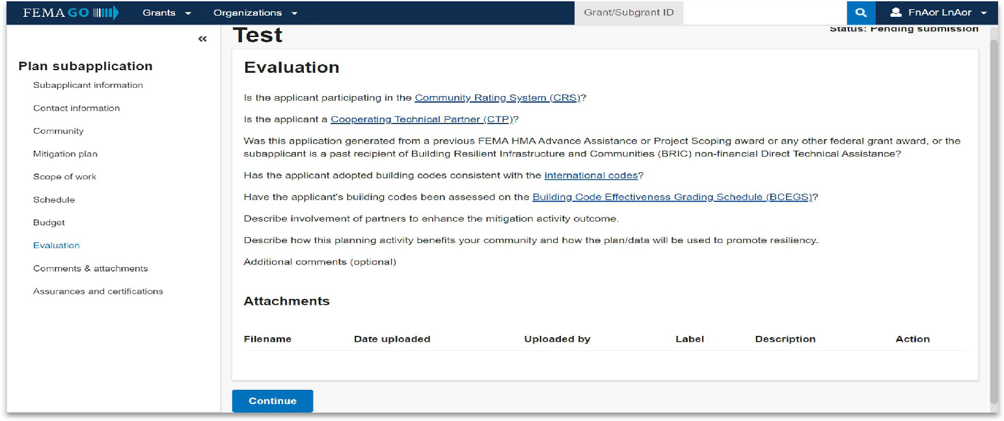
Evaluation

Slide 23
Comments and Attachments
Section 8: Comments and Attachments
Review attachments and add any comments
Select Continue

Slide 24
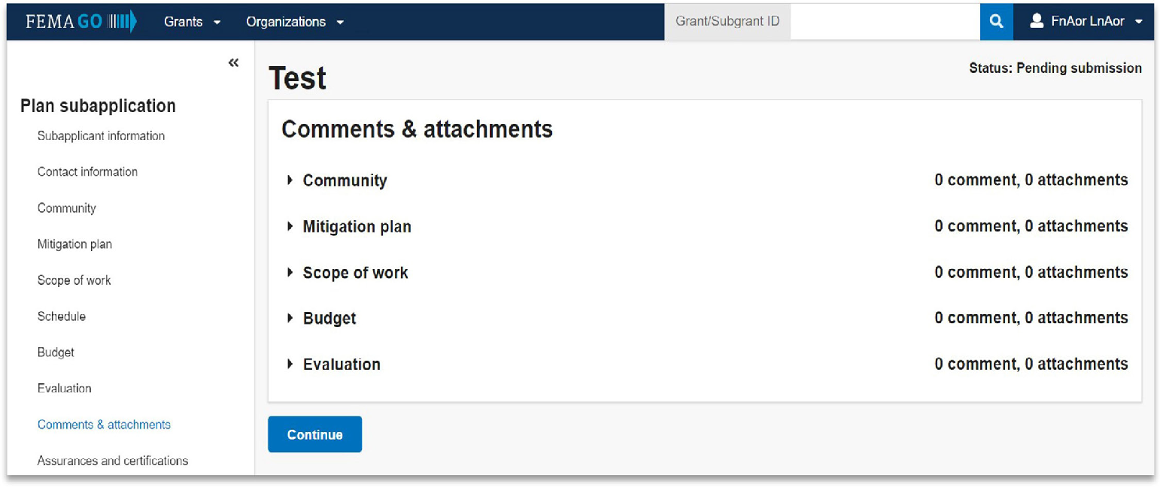
Comments and Attachments

Slide 25
Assurances and Certifications
Section 9: Assurances and Certifications
Check the box if submitting a SF-LLL is not required
If an SF-LLL is required, you MUST complete the drop-down questions and answer all questions
Select Continue

Slide 26
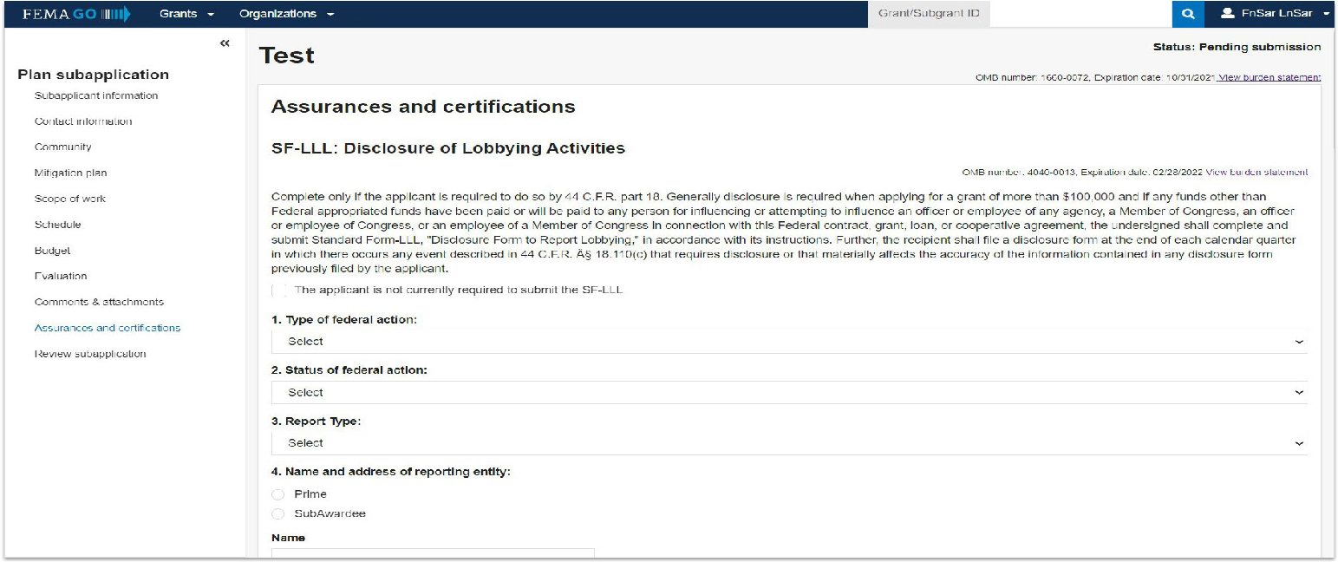
Assurances and Certifications

Slide 27
Review & Submit
Section 10: Review and Submit Subapplication
Resolve any errors that may have been flagged in red
Select Submit for signature by the SAR

Slide 28
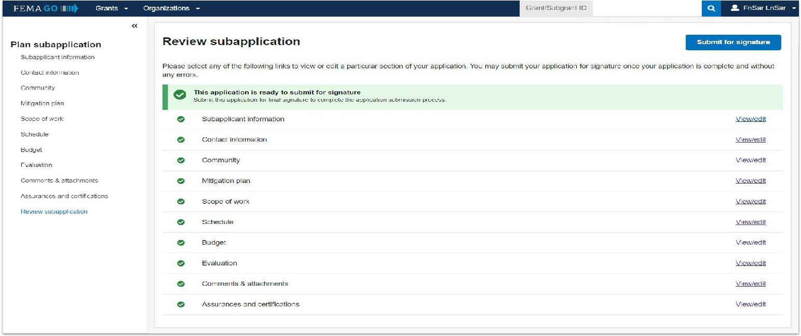
Review & Submit

Slide 29
SAR Only Actions
Sign and Submit: SAR Only
Check each of the certification statements and type in your password to confirm
Select Submit

Slide 30
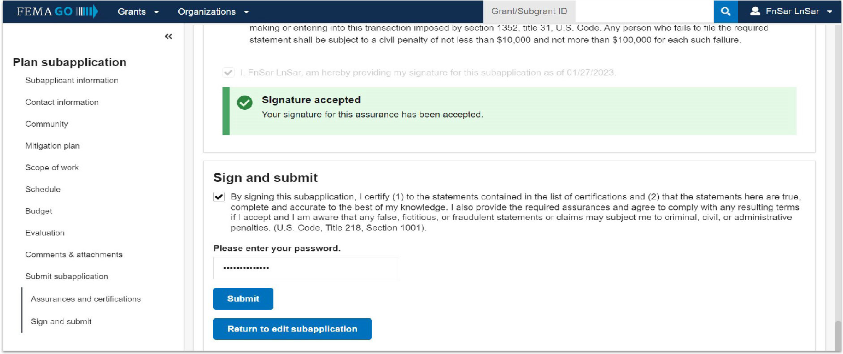
SAR Only Actions

Slide 31
FEMA GO Help Desk Information
FEMAGO@fema.dhs.gov
1-877-585-3242
Hours: Mon-Fri, 8:00 a.m. – 5:00p.m. ET

Slide 32
Prerequisites
Subapplicants are required to have a FEMA-approved Local or Tribal Hazard Mitigation Plan by the application deadline and at the time of obligation of grant funds for hazard mitigation projects.
Subapplicants are exempt from the hazard mitigation plan requirement for the following Capability and Capacity Building activity types:
Hazard mitigation planning and planning related activities,
Partnerships, and
Building codes.
Mitigation projects must be consistent with a State Mitigation Plan and Local or Tribal Mitigation Plan

Slide 33
Minimum Project Criteria
Does your project conform to the State/County Hazard Mitigation Plan?
Does your application meet environmental requirements (EHP)?
Does your project solve a problem independently?
Is your project cost-effective (BCR ≥ 1.0)?
Benefit Cost Analysis (BCA) required for all projects $1 million or above

Slide 34
What is Ineligible?
Debris removal, Stream - related work.
Major structural projects - dams, berms, etc.
Mitigation for damaged infrastructure that can be funded under the Public Assistance Program.
Projects that do not reduce the risk to people, structures, or infrastructure.
Projects for which actual physical work has occurred prior to award

Slide 35
What is Ineligible?
Projects constructing new buildings or facilities.
Exceptions are Safe Rooms
Projects that address operation, deferred or future maintenance, repairs, or replacement.
Studies not directly related to design and implementation of a proposed project. i.e. floodplain studies, Environmental and Historic Preservation (EHP), environmental considerations.
Preparedness measures and response equipment.

Slide 36
Procurement
Build America, Buy America Act (BABAA)
Must ensure all iron, steel, manufactured products, and construction materials used in infrastructure projects are produced in the United State
Contracts must include a contract provision explaining the BABAA requirements and self-certification of compliance with the domestic preference requirements
Allowable waiver types:
Non-Availability
Unreasonable Cost
Public Interest

Slide 37
Things to know
Label all attachments and mention them in the section where they apply
FEMA may require that an updated schedule be submitted upon award
Subapplicants must be aware that pre-award costs are undertaken at their own risk; those costs will not be reimbursed if the Subapplication is not awarded
Once you add a Subapplication in FEMA GO, you can not remove it

Slide 38
DEMA Process
Subapplicant will receive email from DEMA to begin Subapplication
Complete the first draft of the Subapplication through FEMA GO
First draft with edits will be submitted back to you
Subapplicant will have the option to make edits based on DEMA feedback, then Subapplicant will re-submit the application back to DEMA
DEMA will verify edits/recommendations and add further corrections or advise Subapplicant to submit subapplication to DEMA through FEMA GO

Slide 39
Questions
Destiny Colorado State Hazard Mitigation Officer Office: (602) 464-6499 Mitigation@azdema.gov

Slide 40
Thank you!
For more information about DEMA, visit dema.az.gov.

