Slide 1
BRIC and FMA Review and Rank Walkthrough

Slide 2
Agency Mission
The Department's mission is to provide military and emergency management capabilities to citizens of Arizona and the Nation.

Slide 3
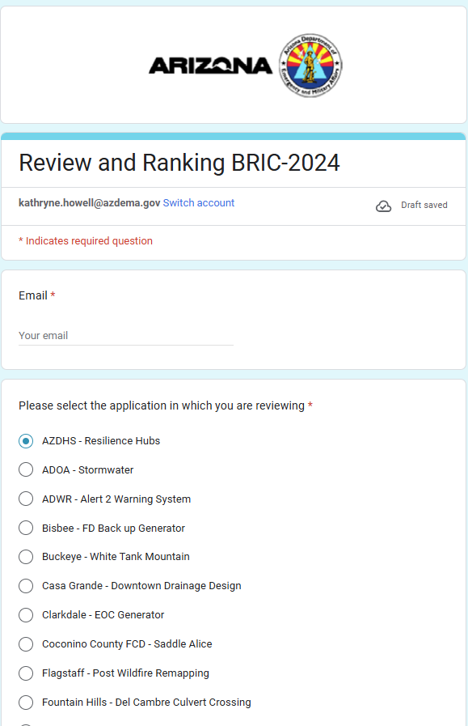
General Information
Getting Started
Quick note: Questions and key words will be bolded and/or defined
Enter your e-mail address
Click the SubApplication you are reviewing

Slide 4
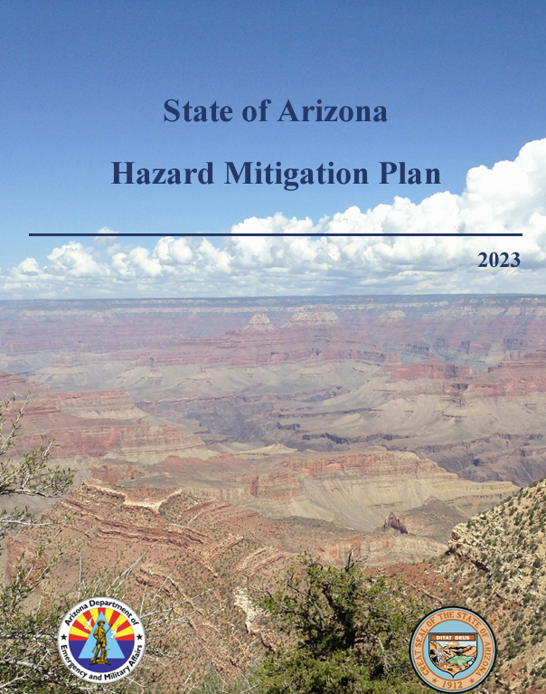
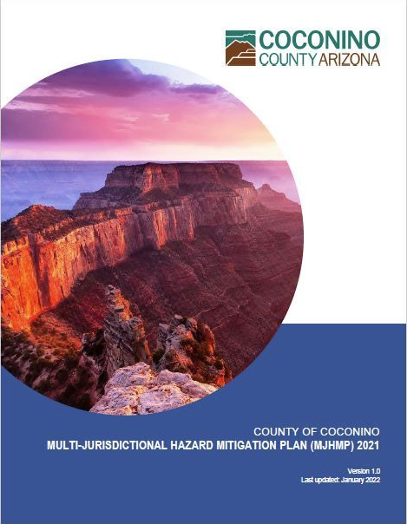
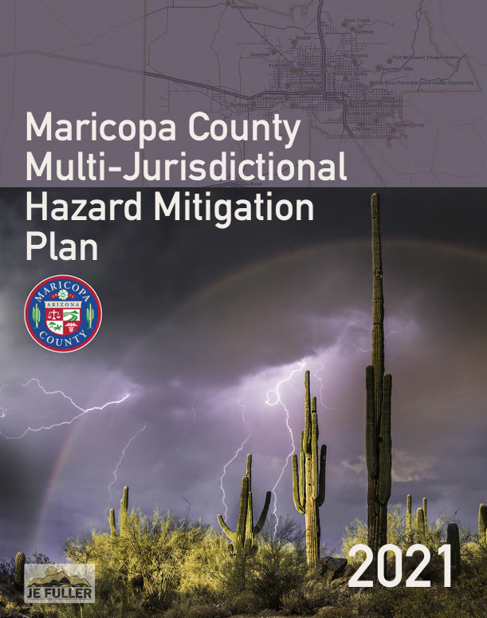
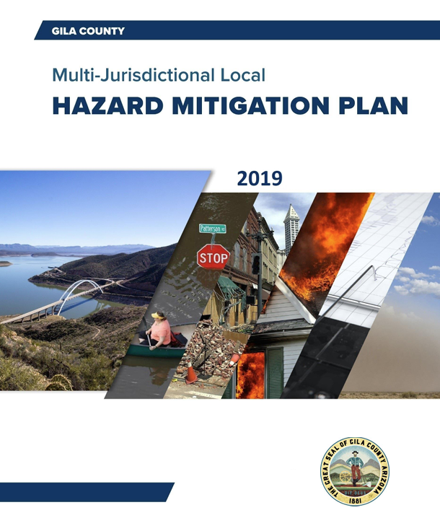
Review and Rank for BRIC & FMA
Does the SubApplicant have a FEMA approved, up to date, Hazard Mitigation Plan (HMP)?
Hazard Mitigation Plan (HMP): document prepared by state, tribal, or local governments that identifies natural disaster risks and vulnerabilities within their jurisdiction.

Slide 5
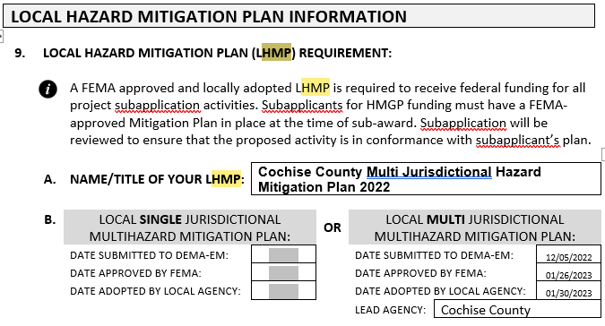
Review and Rank for BRIC & FMA (cont.)
Mitigation Plan Location
BRIC & FMA SUBAPPLICATIONS
Mitigation Plan Location
HMGP SUBAPPLICATIONS

Slide 6
Review and Rank for BRIC & FMA (cont.)
Is this NOI for a Mitigation Project?
Mitigation Project – a project that aims to reduce or eliminate the potential damage caused by natural hazards to a structure by proactively modifying or reinforcing. Essentially, it's any construction activity designed to minimize future natural disaster impacts on a building or property.
Examples - Construction of levees, floodwalls, and drainage systems to protect against flooding. Retrofitting or relocating critical infrastructure to make it more resilient to natural disasters. Implementing measures to prevent erosion and stabilize soil in areas prone to landslides or severe storms. Creating defensible spaces and implementing vegetation management to reduce wildfire risk.

Slide 7
Review and Rank for BRIC & FMA (cont.)
Mitigation Project Type Location
BRIC & FMA Subapplication
Mitigation Project Type Location
HMGP Subapplication

Slide 8
Review and Rank for BRIC & FMA (cont.)
Is this NOI for a Planning Project?
Mitigation Plan – Activities that help communities develop and enhance their hazard mitigation plans and strategies. These projects aim to identify risks, assess vulnerabilities, and create action plans to reduce the impact of future disasters.
Common Examples – Creating, updating, and adding to a local or tribal Hazard Mitigation Plans.

Slide 9
Review and Rank for BRIC & FMA (cont.)
Is this NOI for a Project Scoping Proposal?
Scoping Projects - designed to develop mitigation strategies and obtain data to prioritize, select, and develop, in a timely manner, complete applications that result in either an improvement in the capability to identify appropriate mitigation projects or in the development of an application-ready mitigation project for BRIC or another funding opportunity.
Common examples – Engineering design, feasibility studies, Identify vulnerabilities, develop strategies and building code projects.

Slide 10
Review and Rank for BRIC & FMA (cont.)
Is this NOI for a Building Code related project?
Building Code: carrying out eligible building code adoption and enforcement activities such as:
Evaluate adoption and/or implementation of codes that reduce risk
Enhance existing adopted codes to incorporate more current requirements or higher standards
Develop professional workforce capabilities relating to building codes through technical assistance and training
In Arizona, building codes are adopted and enforced at the local level, meaning each city or county may have its own specific codes.
Most communities follow the Internation Codes (I-Codes), which are developed by the International Code Council (ICC).

Slide 11
Review and Rank for BRIC & FMA (cont.)
Is the NOI realistic, technically feasible, & effective proposal?
Realistic - the proposed project is practical and achievable given the available resources, technology, and timeframe.
Technical Feasibility - the practicality and likelihood of successfully implementing the proposed project based on current technology, engineering standards, and available resources.
Effective - the proposed project will achieve its intended goals of reducing risk and enhancing community resilience to natural hazards. It should demonstrate clear, measurable outcomes and long-term benefits, ensuring that the investment will significantly mitigate risks and protect people and property.

Slide 12
Review and Rank for BRIC & FMA (cont.)
Does the proposal leverage partnerships?
Partnerships - Applicants demonstrate this by providing a detailed explanation of the proposed partnership activity, expected milestones and planned deliverables.
Note: Look for clear identification of partners involved, detailed descriptions of collaboration, evidence of how partnerships enhance project outcomes, and letters of support or Memorandum of Understanding (MOU) from partners to demonstrate commitment.

Slide 13
Review and Rank for BRIC & FMA (cont.)
Does the proposal appear to be cost effective?
Cost effective: A cost-effective project shows a positive return on investment and justifies the use of federal funds to achieve the intended risk reduction outcomes.

Slide 14
Review and Rank for BRIC & FMA (cont.)
Does the proposal reduce risk to life safety & property damage?
Life Safety – refers to measures and projects that protect human life from the impacts of natural hazards.
Examples of Life Safety – Installing backup generators for hospitals to ensure they remain operational during power outages, which is crucial for maintaining life-saving equipment and systems.
Property Damage - involves implementing projects and strategies that minimize the impact of natural hazards on buildings, infrastructure, and other physical assets.
Examples of property damage – building a levee to prevent flooding in a town down stream.

Slide 15
Review and Rank for BRIC & FMA (cont.)
Can the proposal be completed in (3) years?
Period of Performance (POP) – timeframe during which the grantee must complete the grant activities and expend the approved funds.
Review the schedule section of the application

Slide 16
Review and Rank for BRIC & FMA (cont.)
Does the proposal protect infrastructure?
Definition of Infrastructure - Facilities, systems, and structures that are developed, owned, and operated by the government, and are open to the public for use.
Common examples: Flood protection, microgrid installation, and stormwater management.

Slide 17
Review and Rank for BRIC & FMA (cont.)
Does the proposal mitigate FEMA Community Lifelines?
FEMA “Community Lifelines” - the most fundamental services in a community that enable the continuous operation of critical government and business functions and are essential to human health and safety or economic security.

Slide 18
Review and Rank for BRIC & FMA (cont.)
Does the proposal incorporate nature-based solutions?
Nature-based solutions: sustainable planning, design, environmental management, and engineering practices that integrate natural features or processes into the built environment to promote adaptation and resilience.
Examples of Nature-based solutions: Using natural features and processes to combat climate change, reduce flood risk, improve water quality, protect coastal property, restore and protect wetlands, stabilize shorelines, reduce urban heat, and add recreational space.

Slide 19
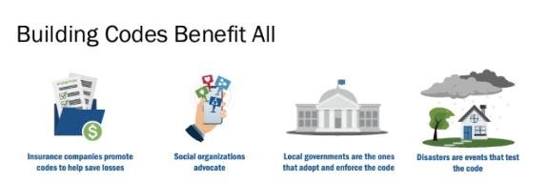
Review and Rank for BRIC & FMA (cont.)
Building Code Effectiveness Grading Schedule (BCEGS)?
Building Code Effectiveness Grading Schedule (BCEGS) = rating scale that is used to evaluate and grade communities on how well they enforce their building codes, especially those related to mitigation losses from natural hazards.
Scale ranges from 1 to 10
1 = Exemplary commitment to building code enforcement
10 = Minimal or no commitment to building code enforcement

Slide 20
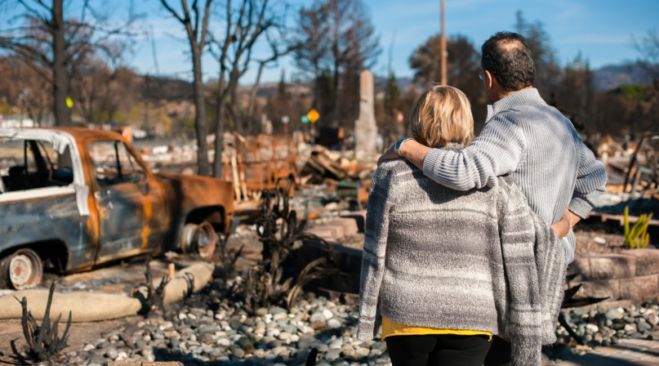
Review and Rank for BRIC & FMA (cont.)
Is the Sub-Applicant designated as a small impoverished community?
Small Impoverished Communities - Economically disadvantaged rural communities (EDRC): Community of 3,000 or fewer. PLUS, Economically disadvantaged, with residents having an average per capita annual income not exceeding 80% of the national per capita income, based on the best available data. Subapplicants must certify and provide supporting documents.

Slide 21
Review and Rank for BRIC & FMA (cont.)
Does this project seem eligible?
Eligibility -- Refers to whether a project or applicant meets the specific criteria and requirements set forth by FEMA for receiving BRIC funding.
If the project aligns with the criteria previously discussed, including feasibility, cost effectiveness and it fits within (Project, Plan, Scoping), select Yes. If it does not, select No.

Slide 22
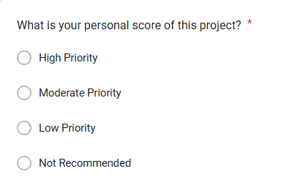
Review and Rank for BRIC & FMA (cont.)
What is your personal score for this project?

Slide 23
Questions
Destiny Colorado State Hazard Mitigation Officer Office: (602) 464-6499 Mitigation@azdema.gov

Slide 24
Thank you!
For more information about DEMA, visit dema.az.gov.

