Slide 1
Benefit-Cost Analysis Workshop
Introduction to Information Needed to Complete a BCA and Potential Sources of Documentation
Notes:
Hello, and welcome to today’s workshop on Benefit-Cost Analysis (BCA). I’m Kevin Miller, and I’m the BCA program Manager, this is a new position within the state, so I will make sure to answer any questions you have or find you the answers you need. Today’s session will be an introduction to information needed to complete a BCA and potential sources of documentation.

Slide 2
Agency Mission
The Department's mission is to provide military and emergency management capabilities to citizens of Arizona and the Nation.

Slide 3
Purpose of this BCA Workshop
Introduce the FEMA benefit-cost analysis (BCA) and its purpose
Identify what information is needed to complete a BCA using FEMA’s BCA Toolkit
Identify where/how to obtain this information
Notes:
The purpose of this BCA workshop is to introduce the FEMA BCA, to provide an introduction to what information is needed to complete a BCA using FEMA’s BCA Toolkit, and to identify where/how to obtain this information.

Slide 4
Agenda
Introduction
What is a BCA and why is it needed?
Components of a BCA
What kind of information is needed to complete a BCA?
Documenting the BCA for all projects
What documentation do you need for the BCA and what are some potential sources?
Best practices for all projects
Basic documentation needed for all projects
Q&A
Notes:
I understand that all this information is dry, so I’ll do my best to present it an easy to understand way. This presentation will be on our website within the week, and of course, feel free to reach out with any questions.
For today's agenda, we will start with an introduction, which will cover what a BCA is and why it is needed. ​
Next, we will discuss components of a BCA, specifically what kind of information is needed to complete a BCA. ​
After that, we will discuss documenting the BCA for all project types. This section will cover what documentation is needed for the BCA and some potential sources to get this documentation. We will also cover best practices and basic documentation needed for all projects. ​
We will end with time for questions. During this presentation, please feel free to enter your questions in the chat, and we will address them at the end. ​

Slide 5
Introduction
What is a BCA, and why is it needed?
Notes:
In this introduction section, we will explore what a BCA is and why it is needed.

Slide 6
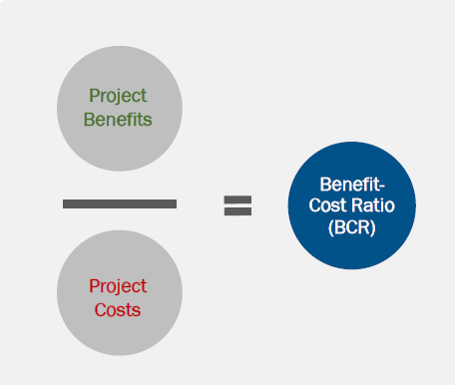
What is a BCA?
A benefit-cost analysis (BCA) is the process of quantifying the benefits of an action versus the costs.
A BCA can be conducted for a project to evaluate cost-effectiveness.
A benefit-cost ratio (BCR) is a numerical expression of cost-effectiveness:
BCR = (Project Benefits)/(Project Cost)
Notes:
To begin, what is a BCA? In simple terms, a BCA is the process of quantifying the benefits of an action versus the costs. A BCA can be conducted for a project to evaluate whether it is cost-effective. In other words, is the project worth completing?
A benefit-cost ratio, or BCR, is how we express cost-effectiveness in numerical terms. The BCR is simply the project benefits divided by the project cost.

Slide 7
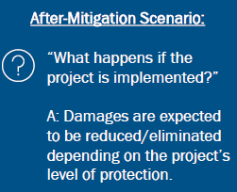
What is a BCA? (cont.)
BCA compares before-mitigation conditions to after-mitigation conditions.
BCA captures risk reduction in terms of losses avoided. Risk is the severity and likeliness of an event occurring.
Losses are calculated based on the size (recurrence interval or frequency of the event) and are determined based on:
Historical costs/damages
Calculations from engineering analysis
Estimated losses
If damages are reduced after mitigation is implemented, then there are benefits to count.
Benefits = future avoided losses
If the benefits are greater than costs (BCR>1.0), the project is cost-effective.
Notes:
When evaluating hazard mitigation projects, the BCA compares before-mitigation conditions to after-mitigation conditions.
If the project is not implemented, then the project area continues to experience damages similar to the past. Since there is no change to improve the existing condition, one could expect there to be similar damages when a natural hazard event of a particular magnitude occurs.
However, if the project is implemented, the damages are expected to be reduced or eliminated based on the project’s level of protection
For a BCA, losses are calculated based on the size (in other words, recurrence interval, or frequency of the event). Losses describe the damages that would occur before and after mitigation. Losses can be determined based on historical costs/damages, calculations from engineering analysis, or estimated.
If damages are reduced after the mitigation project is implemented, then there are benefits to count. This means that as a result of doing the project, losses were avoided.
If the benefits are greater than costs (BCR>1.0), the project is called “cost-effective.”

Slide 8
Why is a BCA Needed?
The purpose of a BCA is to determine whether a hazard mitigation project is an efficient use of FEMA Hazard Mitigation Assistance (HMA) funding.
To be eligible for HMA funding, FEMA requires hazard mitigation projects to have a BCR greater than 1.0.
Helps communities prioritize projects
Statutory and regulatory drivers set the requirement to show cost-effectiveness.
Stafford Act
Title 44 Code of Federal Regulations
Office of Management and Budget Circular A-94
Notes:
Now that we’ve discussed what a BCA is, let’s talk about why a BCA is needed.
The purpose of a BCA is to determine whether a mitigation project is an efficient use of HMA funding. The BCA is a way of determining future risk reduction benefits of a project and comparing those benefits to the costs. BCAs can also help communities prioritize which projects they would like to pursue first – project with greater BCRs provide greater benefits.

Slide 9
How do I Demonstrate Cost-Effectiveness?
Notes:
So, what FEMA-approved methodologies and tools are used to evaluate cost-effectiveness?
Mitigation projects $1 million (federal share and local share combined) and up require a BCA, but some projects types that meet certain criteria qualify for “precalculated benefits”. If a project qualifies for precalculated benefits, then a standalone BCA is not needed.
If a project does not qualify for pre-calculated benefits, then a BCA must be completed using the FEMA BCA Toolkit Version 6.0, which is an Excel-based toolkit and has FEMA-approved methodologies and tools to show cost-effectiveness. The toolkit includes different modules for various natural hazards. It requires an online connection and automatically updates whenever there is a software update.
Certain project types, such as acquisitions/elevations in the special flood hazard area, residential hurricane wind retrofits, nonresidential hurricane wind retrofits, individual tornado safe rooms, post-wildfire mitigation activities, and hospital generators have established precalculated benefits. This presentation does not focus on precalculated benefits, but additional information on these, including the pre-calculated benefits memoranda (which outline the requirements for using precalculated benefits) can be found at the website in the blue box.
The FEMA Toolkit was developed in accordance with Circular A-94

Slide 10
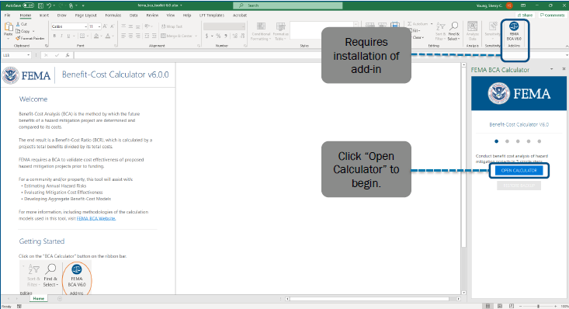
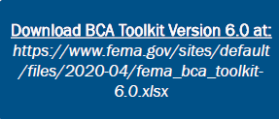
FEMA BCA Toolkit Version 6.0
Notes:
To download the FEMA BCA Toolkit, go to the FEMA BCA website and follow the toolkit installation instructions. To use the toolkit, you will need to install an add-in to Excel.
If you experience difficulties installing the BCA Toolkit add-in, please contact your IT department for help with this. We have had partners who IT department block the use of add-ins.

Slide 11
Components of a BCA
What kind of information do you need to complete a BCA?
Notes:
In this section, we will discuss what kind of information is needed to complete a BCA.

Slide 12
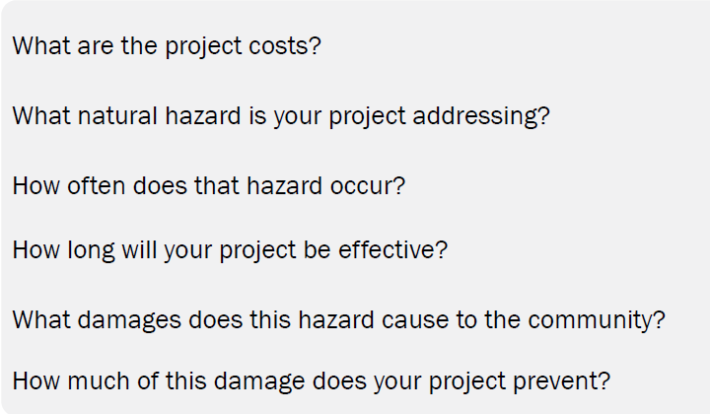
What minimum information do you need for a BCA?
Notes:
To complete a BCA, there are several main components that will need to be addressed.
First, what are the project costs?
Then, what natural hazard is your project addressing? Keep in mind that in order to be eligible, mitigation projects must address a natural hazard. In other words, man-made hazards such as cyber attacks would not be eligible.
Next, we will need to know how often the hazard occurs.
Projects can only be effective for a certain amount of time. So, we would need to know how long the project will provide benefits.
Next, what kinds of damages does the hazard cause to the community?
Finally, how much of this damage does your project prevent?

Slide 13
What are the project costs? $
Initial project cost
All costs required for completing the mitigation project, regardless of who is paying for them.
Annual maintenance cost
Costs needed for upkeep/repair of mitigation project components to keep project to desired level of effectiveness.
Total mitigation project cost = initial project cost + annual maintenance costs
Future maintenance costs are discounted to present value.
Notes:
Let’s discuss the first component – what are the project costs?
The initial project cost includes all costs required for completing the mitigation project, regardless of who is paying for them. Costs of a mitigation project would include more than just the construction costs. For example, they could include land acquisition, design, permitting, construction labor and materials, construction oversight, and closeout costs, etc. Note that any in-kind contributions or match from the recipient or subrecipient would be included in the project costs.
Annual maintenance costs are the costs needed for upkeep and repair of project components to keep the project to the desired level of effectiveness. Maintenance costs can include activities like road maintenance, drainage network inspections and debris removal, landscaping maintenance, and other types of site maintenance. Note that the annual maintenance costs are the responsibility of the subapplicant and are not funded by FEMA but must be considered in the BCA since they apply to the project costs over the project useful life.
The total mitigation project cost is equal to the initial project cost, plus the annual maintenance costs. Future maintenance costs are discounted to present value, using the discount rate of 7 percent set by the US Office of Management and Budget, so that all future costs could be evaluated in present value.
For example, $1,000 in annual maintenance costs over 30 years at a 7 percent discount rate results in adding $12,409 to the total project cost instead of $30,000 ($1,000 × 30).

Slide 14
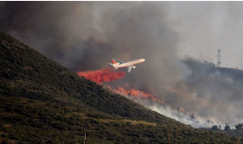
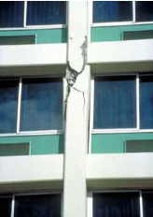
What natural hazard is your project addressing?
Eligible mitigation projects must address one or more natural hazards.
Floods
Earthquakes
Wildfires
Hurricane winds
Tornados
Landslides
Notes:
For mitigation projects to be eligible, they must address a natural hazard, such as floods, earthquakes, wildfires, hurricanes, tornados, or landslides. In other words, man-made hazards such as cyber attacks would not be eligible.
However, some structures are man-made and failure to these structures could be a result of human actions. For example, dams and levees are man-made, but improvements to these structures are eligible. Dam breaks and levee failures could occur as a result of human actions. Many wildfires also result directly from human actions. Note that mitigation actions to address these situations would be eligible.

Slide 15
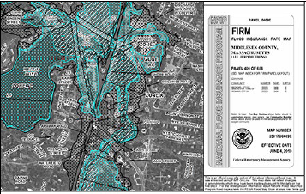
What natural hazard is your project addressing?
We cannot predict when a hazard will occur, but we can estimate how likely it is to occur based on historical events, hazard data, or specific hazard analyses (such as a hydrologic and hydraulic [H&H] study or fault rupture analysis).
How often a hazard occurs is often represented by a recurrence interval (RI).
A RI is how often a hazard event of specific severity is likely to occur in a particular location.
Often expressed in years.
It is the inverse of the annual probability of an event.
Example:
RI of a flood is 100 years
Probability of occurring in any one year = 1/100 = 0.01
Annual probability = 1%
Notes:
The next component of a BCA describes how often that hazard occurs. For example, is your project proposing to mitigate flooding from drainage problems where a little bit of damage is occurring several times a year? Or is the project proposing to mitigate flooding from a large hurricane that does not occur often?
We cannot predict when a hazard will occur, but we can estimate how likely it is to occur based on historical events, hazard data, or specific hazard analysis.
How often a hazard occurs is often represented by a recurrence interval (RI). A recurrence interval is how often a hazard event of a specific severity is likely to occur in a particular location. The RI is often expressed in “years” and is the inverse of the annual probability of an event.
Projects that mitigate more frequent events are more likely to be cost-effective. This is because damages are likely to be expected more often, as the events are occurring more frequently.
So, for example, when we say the recurrence interval of a flood is 100 years, this means that in any given year, there is a 1/100, or 0.01 chance that it will occur. Therefore, the annual probability is 1%.
Example of Hazard Analysis :such as a hydrologic and hydraulic [H&H] study or fault rupture analysis.

Slide 16
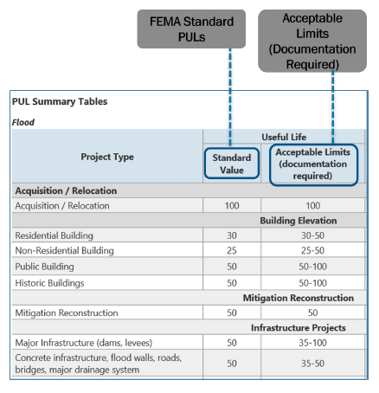
How long will your project be effective?
Improvements to the built environment do not last forever.
Mitigation projects can only be relied upon to provide benefits for a finite amount of time.
BCA Toolkit evaluates benefits over the project useful life (PUL).
Project useful life = estimated amount of time (in years) that the mitigation action will be effective.
Depends on the project type.
Can be thought of as the “design life.”
FEMA has standard PULs for most project types.
Provide documentation if a nonstandard value is used.
Notes:
The next important component of a BCA relates to how long your project will be effective for.
Because improvements to the built environment do not last forever, mitigation projects can only be relied upon to provide benefits for a finite amount of time. Even with maintenance, the project will eventually become old and require replacement.
This is an important concept for the BCA. The BCA toolkit evaluates benefits over the project useful life, which is the estimated amount of time (in years) that mitigation action will be effective. The project useful life (PUL) depends on the type of mitigation action and is often thought of as the “design life.” FEMA has established standard project useful lives for most project types. The figure to the right shows the PUL summary table from the BCA Help Menu, which can be found at the upper right corner of the BCA Toolkit by clicking the “i” icon. As noted, the left column shows the FEMA standard value for the project type, and the right column shows acceptable limits. When using nonstandard values, appropriate documentation must be provided to support use of the value and it must be within the acceptable limits. This is a very important point, if you go outside the set limits, make sure you have the documentation to back it up.
Keep in mind that the PUL establishes the time frame to calculate benefits. Higher PUL values means benefits are calculated over a longer time frame, thereby raising the benefit-cost ratio.

Slide 17
What damages does that hazard cause the community? (1 of 8)
What kind of losses would be avoided by completing the mitigation activity?
Benefits = future avoided losses
Benefits can include:
Avoided physical damages
Avoided injuries/loss of life
Avoided loss of function
Social benefits (avoided mental stress and lost productivity)
Avoided emergency response costs
Avoided volunteer costs
Ecosystem services benefits (enhancing land use in a way that provides a higher level of natural ecosystem benefits)
Notes:
Next, what damages does that hazard cause to the community? In other words, what kind of damages would be avoided by completing the mitigation activity? Benefits are any future damages that could be avoided by completing the mitigation project.
Benefits can include avoided physical damages, injuries/loss of life, loss of function, social benefits (in other words, avoided mental stress and lost productivity), emergency response costs, volunteer costs, or ecosystem services benefits (for projects that enhance land use in a way that provides a higher level of natural ecosystem benefits). We will discuss each of these in detail in the following slides.

Slide 18
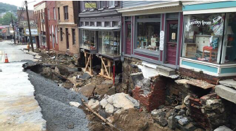
What damages does that hazard cause the community? (2 of 8)
Physical damages
Damages to facilities requiring repair or replacement of structures, contents, roads/bridges, and/or utilities.
Injuries/loss of life
Typically counted only for certain project types that address hazards where there is little or no warning time, or when emergency personnel must stay behind
Benefits depend on the affected building occupancy/population.
Notes:
Physical damages include damages to facilities requiring repair or replacement of structures, contents, roads/bridges, and/or utilities. For example, suppose we have a flood-prone property that is in the special flood hazard area. If the property is acquired and demolished, then it will no longer be subject to damages from flooding. That means these damages have been avoided by completing the mitigation project.
Avoided injuries and loss of life are another benefit that can be realized from a mitigation project. Benefits for avoided injuries and loss of life are typically counted only for project types that address hazards where there is little or no warning time, or when emergency personnel must stay behind.
For example, these project types would include tornado safe rooms, seismic retrofit projects, and wildfire mitigation projects. The toolkit has established values for injuries and loss of life, which get multiplied by the building occupancy or population affected to determine injuries/loss of life benefits.

Slide 19
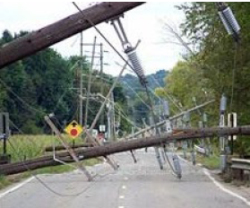
What damages does that hazard cause the community? (3 of 8)
Loss of function
Interruption to roads/bridges, utilities, residences, nonresidential buildings, and critical services because of a natural hazard event.
Benefits depend on value of the function and length of interruption.
Could also include “displacement” costs for buildings.
In other words, “displacement” costs = costs associated with temporary stay at another comparable location while repairs are made.
Notes:
Avoided loss of function is another benefit that could be realized by completing the mitigation project. Loss of function means there is an interruption to roads/bridges, utilities, residences, nonresidential buildings, and critical services because of a natural hazard event.
For example, a flood may cause a road bridge to collapse and require there to be a road detour. Electrical lines could be down after a wildfire, resulting in loss of electrical service. Or, a hospital’s facilities may be damaged during a flood and patients cannot be treated.
Loss of function benefits will depend on the value of the function and the length of interruption. Loss of function could include include displacement costs for buildings. In other words, a building’s occupants must displace to a similar facility to continue functioning. These costs are associated with a temporary stay at another location while repairs are made. For example, a three day loss of power or road access to a dairy farm would have significant business losses and affect the employees which in turn would have impacts on the local economy.
Loss of function benefits are calculated differently in the toolkit depending on the type of facility that loses function. In the following slides, we’ll look at how this applies for different cases.

Slide 20
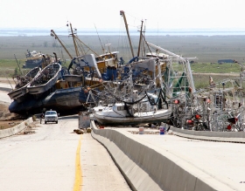
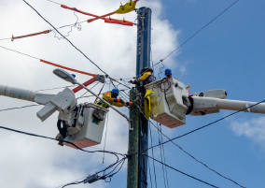
What damages does that hazard cause the community? (4 of 8)
Loss of function for roads/bridges
Benefits will depend on increased time and distance of detour needed when a road/bridge is lost and downtime length.
Provide estimated number of one-way traffic trips per day, additional time per one-way trip (minutes), number of additional miles.
BCA Toolkit provides standard value for mileage rate and delay time.
Loss of function for utilities
Benefits calculated based on the value of service ($/person/day), multiplied by the number of customers served and the duration of the loss of function.
BCA Toolkit provides standard values ($/person/day) for electrical, potable water, and wastewater service.
Notes:
For roads and bridges, loss of function benefits are calculated based on the increased time and distance of the detour needed when the service or a road or bridge is lost. The detour route and downtime length would be important information. The value of service is estimated based on the number of one-way trips, additional time per one-way trip (minutes), and number of additional miles. The BCA toolkit provides a standard value for the mileage rate and delay
For utilities, loss of function benefits are calculated based on the value of service ($/person/day) for that particular utility type, multiplied by the number of customers served and the duration of the loss of function. The BCA toolkit provides standard values for electrical, potable water, and wastewater service.
For example, electrical: $174/person/day, potable water: $114/person/day, wastewater: $58/person/day. FEMA updates these values periodically.

Slide 21
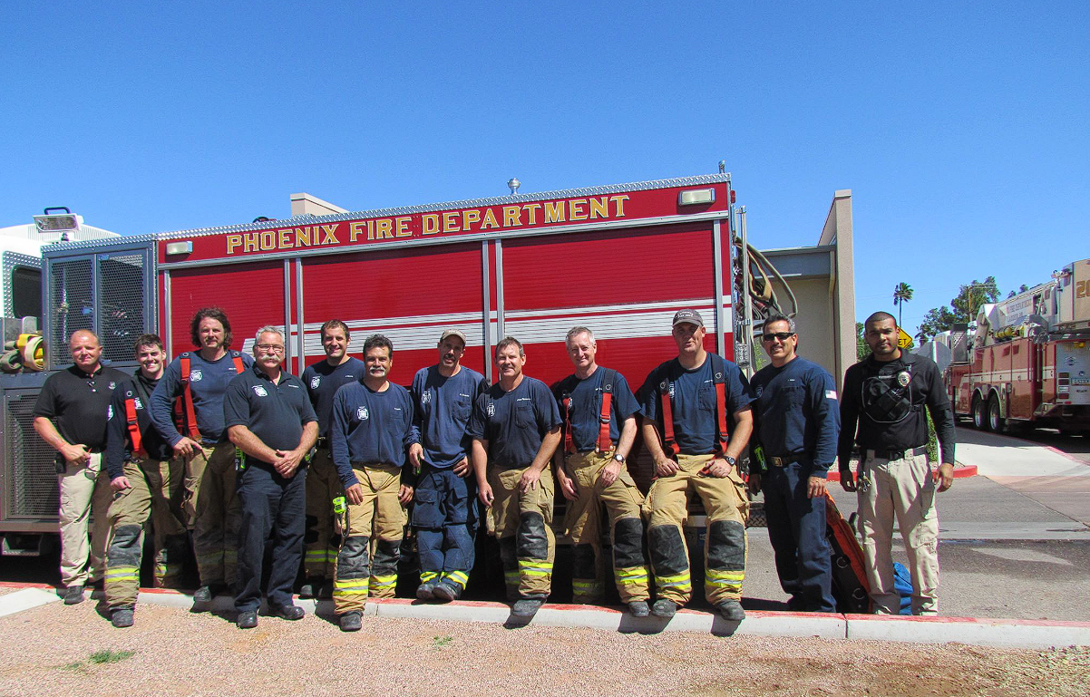
What damages does that hazard cause the community? (5 of 8)
Loss of function for critical facilities
Benefits based on mitigating loss of service by allowing police stations, fire stations, and hospitals to stay open or reduce their downtime.
BCA Toolkit determines value of service per day for police stations, fire stations, and hospitals based on specific inputs.
Fire station: Provide service population, type of area served (urban/suburban/rural/wilderness), distance to closest alternative station, and whether fire station provides emergency medical services.
Hospital: Provide service population, distance to alternative hospital, and service population of alternative hospital.
Police station: Provide type of area served (metro/city/rural), service population, number of police officers, and number of police officers that would serve the area if station were shut down because of a disaster.
Loss of function for ordinary buildings (public/nonprofit sector buildings that provide a public service)
Based on the annual operating budget and duration of time the service is lost.
Notes:
For critical facilities, benefits are based on mitigating loss of service by allowing police stations, fire stations, and hospitals to stay open or reduce their downtime. The BCA toolkit determines the value of service per day for police stations, fire stations, and hospitals based on specific inputs.
If the building is an ordinary building, such as a public/nonprofit sector building that provides a public service, loss of function benefits are based on the annual operating budget and the duration of time that service is lost. In other words, the value of service lost is calculated assuming that services are worth what the public pays to provide the service.
For fire stations, this will depend on the service population, type of area served (urban/suburban/rural/wilderness), distance to closest alternative station, and whether fire station provides emergency medical services.
For hospitals, this will depend on the service population, distance to alternative hospital, and service population of alternative hospital.
For police stations, this will depend on the type of area served (metro/city/rural), service population, number of police officers, and number of police officers that would serve the area if the station were shut down because of a disaster.

Slide 22
What damages does that hazard cause the community? (6 of 8)
Loss of function for residential buildings
Typically calculated as residential displacement costs.
Will depend on # occupants, building type, building replacement value, and duration of displacement.
BCA Toolkit provides default per diem values (lodging and meals) for project location.
Can also include loss of rental income (rental properties) or business income.
Loss of function for nonresidential buildings
Typically calculated as nonresidential displacement costs.
Includes one-time displacements costs and monthly rental costs for comparable building.
Benefits will depend on occupancy class (building use) and duration of displacement.
Can also include loss of rental income (rental properties) or business income.
Notes:
Loss of function for residential buildings and nonresidential buildings are typically represented as displacement costs. It can also include loss of rental income (for rental properties) or business income.
Displacement costs occur when a building’s occupants are displaced to temporary quarters while damage is repaired.
Loss of function for residential buildings will depend on the number of occupants, building type, building replacement value, and the duration of displacement.
The BCA toolkit provides default per diem values (lodging and meals) for the project location. If location specific data is available, for example, from local data, this can be provided for lodging and meals provided appropriate documentation is supplied. Loss of function for residential buildings may also include loss of rental income (for rental properties) or business income. When tenants vacate the premises because of damages, it results in loss of rental income for the owner. However, users should be aware of the potential for double-counting rental income losses. Counting both the displacement costs for the renter and the full loss of rental income for the owner is double-counting and must be avoided. The simplest way to avoid potential double counting is to not count rental income losses.
For nonresidential buildings, displacement costs include one-time costs (such as the costs of moving to the new site) and monthly rental costs for a comparable building. The benefits will depend on occupancy class (building use) and duration of displacement. Similar to residential buildings, loss of function benefits can include loss of rental income and loss of business income.

Slide 23
What damages does that hazard cause the community? (7 of 8)
Ecosystem services benefits
Applies to all types of mitigation projects that enhance land use in a way that provides a higher level of natural ecosystem benefits.
Benefits will depend on project area being improved and the land use type(s) after the mitigation project is complete.
Volunteer costs
Applicable when the project eliminates or reduces the need for volunteer labor.
Benefits will depend on number of volunteers, number of days of lodging for volunteers, and lodging costs.
Notes:
Ecosystem services benefits can be applied to all types of mitigation projects that enhance land use in a way that provides a higher level of natural ecosystem benefits. This is an important benefit to consider when completing a BCA. The benefits will depend on the project area being improved (square feet or acres) and the land use type(s) after the mitigation project is complete. For example, the change from urban land use to open green space as a result of mitigating a structure through acquisition/demolition can be considered an ecosystem benefit.
Any project that eliminates or reduces the need for volunteer labor can claim volunteer benefits. The benefits will depend on the number of volunteers, number of days of lodging for volunteers, and lodging costs. FEMA provides a default value for per diem costs based on the project location.
FEMA has economic valuations for various land uses ($/acre/year), such as green open space, riparian, wetlands, forests, and marine and estuary. Documentation such as an estimate from a project designer should be provided if default FEMA values are not used. Application materials including the scope of work should describe the changes or enhancements in land use that will result in the restoration of Green Open Space, Forest, Marine and Estuary, Riparian, or Wetland areas. Supporting materials can include previous studies or maps depicting the locations and areas of restoration or enhancements in land use to the aforementioned land use type

Slide 24
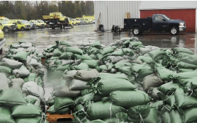
What damages does that hazard cause the community? (7 of 8)
Social benefits
Includes mental stress and anxiety and lost productivity benefits.
Applies to residential structures only.
Must have a BCR of >0.75 to be applicable.
Based on residential building occupancy and number of residents that work.
BCA Toolkit provides mental stress and anxiety and lost productivity values ($/person)
Avoided emergency response costs
Costs include labor, equipment, and materials to perform emergency work.
Notes:
A mitigation project may also provide social benefits by avoiding mental stress and anxiety, as well as lost productivity. Social benefits apply to residential structures only, and the BCR prior to application of these benefits must be at least 0.75. Social benefits are calculated based on the residential building occupancy and the number of residents that work. FEMA provides standard values ($/day) for mental stress and anxiety and lost productivity.
Avoided responses costs include disaster response and recovery costs that may be incurred by communities during and immediately after a disaster, such as the labor, equipment, and material costs to perform emergency work. Examples of avoided response costs include sandbagging before an event, costs to provide a temporary by-pass, costs to close roads, and debris removal costs.

Slide 25
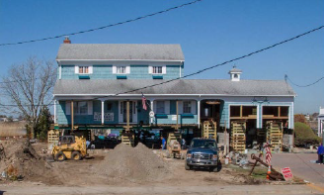
How much of this damage does your project prevent?
To what extent will the project reduce/eliminate physical damages, injuries/loss of life, loss of function, mental stress/anxiety, etc.?
Project level of protection = design level or standard to which the project will be designed to avoid future losses.
Most projects do not eliminate all risk.
Residual damages are present even after the project is implemented.
Exception: Acquisition projects remove structures from the floodplain and therefore fully eliminate flood risk.
Notes:
Now that we’ve discussed the various damages that the hazard could cause to a community, the final component is consideration of how much damage the project prevents. In other words, to what extent will the project reduce/eliminate physical damages, injuries/loss of life, loss of function, mental stress/anxiety, and other applicable losses?
The project’s level of protection refers to the design level or standard to which the project will be designed to avoid future losses. For example, a culvert that previously was designed for the 10-year flood may be replaced with a new culvert designed to the 50-year flood for increased capacity.
It is important to remember that most project do not eliminate all risk. Not all projects will be able to resist damages from any size event, and residual damages will be present even after the project is implemented. For example, if a culvert is designed to accommodate a 50-year flood, a 100-year flood could theoretically overwhelm the anticipated capacity will likely result in damages. One exception to zero residual damages are acquisition projects. Acquisition projects remove structures from the floodplain and therefore fully eliminate flood risks, as the structures are no longer subject to the flood risks previously present.

Slide 26
Documenting the BCA for all projects
What documentation do you need for the BCA and what are some of the potential sources?
Notes:
The next part of this presentation will cover documenting the BCA for all project types. Specifically, what documentation do you need for the BCA and what are some potential sources? We will first review some best practices for documentation that are applicable to all projects. Then, we will cover basic documentation needed for all projects.

Slide 27
Best Practices for All Projects
Provide BCA files (export + pdf), BCA narrative, and all supporting attachments.
Use data from credible and reliable sources (e.g., federal, state, local agencies).
Provide copies of reports, data, and any other technical support information (copy of Flood Insurance Rate Map, Flood Insurance Study, reports from agencies, etc.).
Clearly indicate project’s level of protection.
Provide justification for all inputs that are not FEMA standard/default values.
Notes:
No matter what the project you are dealing with, there are some best practices that should be followed when documenting the BCA.
First, be sure to provide all BCA files (export + pdf), a BCA narrative, and all supporting attachments. This will enable the reviewer to have access to all the same documents used to develop the BCA. As a best practice, include a BCA narrative to explain the logic behind BCA inputs and reference supporting documentation therein. If the project is using pre-calculated benefits, clearly indicate that these are being used (instead of performing a BCA) and provide reference the relevant pre-calculated benefits memoranda.
Be sure to use data from credible and reliable sources (e.g., federal, state, local agencies). If providing a letter from a local agency documenting the data used in the BCA, it is recommended that this letter be on official agency letterhead and signed by a knowledgeable official.
Provide copies of reports, data, and any other technical support information (copy of Flood Insurance Rate Map, Flood Insurance Study, reports from agencies, etc.).
Clearly indicate project’s level of protection. As previously mentioned, the level of protection is important to understand to what degree the project is expected to reduce/eliminate damages and factors into the project’s residual risks.
Provide justification for all inputs that are not FEMA standard/default values. Remember that all values that are nonstandard or nondefault should be accompanied by an explanation/documentation, otherwise use of the value will not be accepted.

Slide 28
Best Practices for All Projects (cont.)
Cite references and locations of relevant data to support BCA inputs.
Organize data via list of attachments/subfolders.
Perform initial BCA analysis with readily available data to determine status of BCR.
Assess whether additional benefits are necessary to show cost-effectiveness.
If project is cost-effective with readily available data, it may not be necessary to gather documentation to support additional benefit categories.
Example: For many nature-based solutions projects, ecosystem services benefits alone may be sufficient to get the project to a BCR > 1.0.
Notes:
Some additional best practices for projects are to cite references and locations of relevant data to support BCA inputs (this will make it much easier for the reviewer to understand the BCA), and to organize data via list of attachments/subfolders.
You may want to perform an initial BCA analysis using readily available data. This will enable you to get a gauge of where the project stands using information that you already have. Following the initial BCA analysis, you can then perform an assessment to determine whether additional benefits are necessary to show cost-effectiveness.
If your project is already cost-effective using readily available data, it may not be worth the effort to gather documentation to support additional benefit categories, such as volunteer costs or environmental benefits.
These are some important considerations to think about as you complete your BCA.
For example, a project may result in a BCR of 0.92 using readily available data. Based on the BCR, you may need only a few additional benefits to get the project to a BCR over 1.0. You may think about any other benefits that were not previously included, but that still apply to your project. For example, are there volunteer costs that could be included? Or perhaps there are avoided emergency response costs that can be added. On the other hand, if your BCR is fairly low, you may recognize that significant improvements to the BCA may be necessary to increase benefits. For example, could there be better data sets available by asking the public works department or other agency that may have studied the project area? Or, would an H&H study be necessary to capture conditions that may be outdated from an older Flood Insurance Study? Finally, if your project is already cost-effective using readily available data, it may not be worth the effort to gather documentation to support additional benefit categories, such as volunteer costs or environmental benefits. Especially for nature-based solutions projects, ecosystem services benefits alone may be sufficient to get the project to a BCR of over 1.0. These are some important considerations to think about as you complete your BCA.

Slide 29
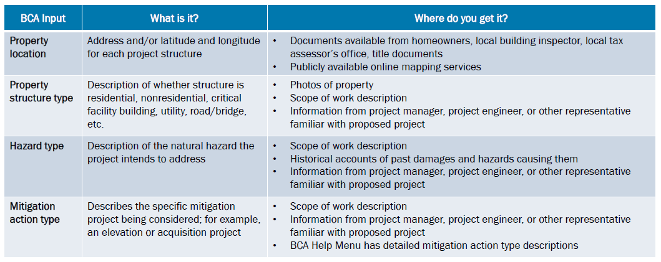
Basic Documentation Needed for All Projects (1 of 3)
Notes:
Now, let’s discuss the basic documentation needed for all projects.
In this slide and the coming slides, we will talk about each BCA input, what the BCA input is, and potential sources (in other words, where do you get it?).
The property location is the address or geographical coordinates of the project structure
The property structure type describes whether the structure is residential, nonresidential, a critical facility building, utility, road/bridge, or other structure type.
The hazard type describes the natural hazard the project intends to address.
The mitigation action type describes the specific mitigation project being considered.
Property Location: The property location may be available from homeowners, local building inspector, local tax assessor’s office, title documents, or publicly available online mapping services.
Property Structure: This may be available from photos of property, the scope of work description. information from project manager, project engineer, or other representative familiar with proposed project.
Hazard Type: The hazard type may come from the scope of work description, historical accounts of past damages and hazards causing them, or information from the project manager, project engineer, or other representative familiar with proposed project.
Mitigation Action Type: The mitigation action type may come from the scope of work description, information from project manager, project engineer, or other representative familiar with proposed project. The BCA Help Menu also has detailed mitigation action type descriptions.

Slide 30
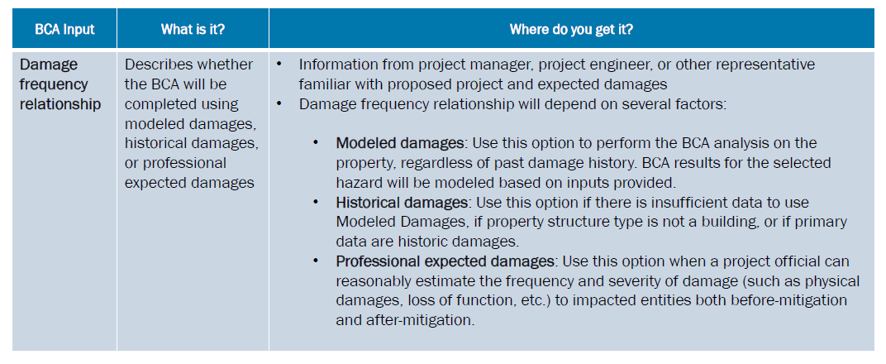
Basic Documentation Needed for All Projects (2 of 3)
Notes:
Next, the damage frequency relationship describes how the BCA will be completed. This information may come from the project manager, project engineer, or other representative familiar with proposed project and the expected damages.
Note that the damage frequency relationship will depend on several factors and knowing when to use each option will be helpful to complete the BCA.
Modeled damages can be used to perform the BCA analysis on the property, regardless of past damage history. BCA results for the selected hazard will be modeled based on inputs provided. This option is not available for hazard or structure types where no model exists for how that hazard impacts the structure.
Historical damages can be used when there is insufficient data to use modeled damages, if the property structure type is not a building, or if the primary data are historic damages.
Professional expected damages should be used when a project official can reasonably estimate the frequency and severity of damage (such as physical damages, loss of function, etc.) to impacted entities both before-mitigation and after-mitigation.

Slide 31
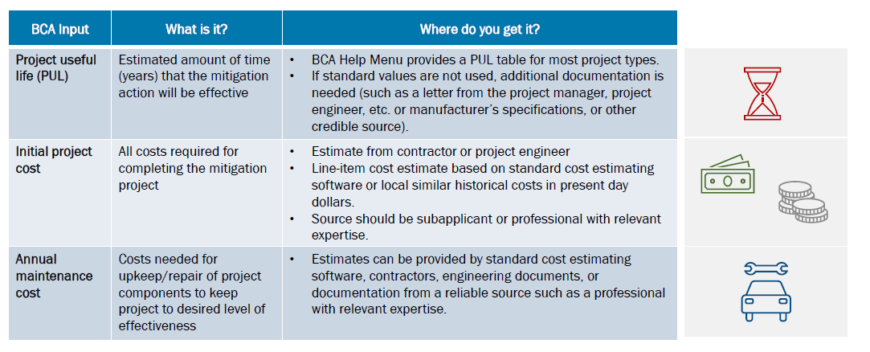
Basic Documentation Needed for All Projects (3 of 3)
Notes:
The project useful life is the estimated amount of time (years) that the mitigation action will be effective. The BCA Help Menu provides a PUL table for most project types. Remember that if standard values are not used, additional documentation is needed (such as a letter from the project manager, project engineer, etc. or manufacturer’s specifications, or other credible source) justifying the PUL must be provided.
The initial project cost includes all costs required for completing the mitigation project. This information may be obtained from an estimate from the contractor or project engineer, a line-item cost estimate based on standard cost estimating software, or local similar historical costs in present day dollars. The cost estimate should be prepared by a the subapplicant or professional with relevant expertise.
The annual maintenance cost is the cost needed for upkeep/repair of project components to keep project to the desired level of effectiveness. Annual maintenance cost estimates can be provided by standard cost estimating software, contractors, engineering documents, or documentation from a reliable source such as a professional with relevant expertise.

Slide 32
Tips to Improve the BCA and Improve the BCR
If the BCA is not cost-effective, how can benefits be increased to improve the BCR?
Increase the number of scenario events used in the BCA.
The more scenario events that are included, the more benefits will be calculated.
Determine if there are more frequent (smaller events) that would impact the project area.
While a larger event may cause greater damages, smaller events with less damages happen more frequently.
Determine if additional benefits can be included in the BCA.
Think about additional benefit categories that may have been missed.
Ensure the most recent data is included in the BCA.
Site conditions may have changed, or there may be a more recent study with updated data.
Notes:
In addition to best practices for all projects, there are a few tips that should be considered to improve the BCA. For example, if the BCA is not over 1.0, there are several things you can do to increase the benefits and therefore raise the BCR.
The first tip is to increase the number of scenario events used in the BCA. For example, if in your BCA, you evaluated only one past historic flood event, then benefits would only be captured for that one flood event. However, if you are aware of other historic flood events that affected the project area, then the damages associated with those other events could potentially be included in the BCA. Therefore, the more scenario events that are included in the BCA, the more benefits will be calculated. The BCA will add up benefits from all the scenario events included.
The second tip is to determine if there are more frequent (smaller) events that would impact the project area. Intuitively, one may think that smaller events cause less damage, and therefore equate to less benefits. However, while smaller events may cause less damages, the fact that they occur more frequently means that these damages will also happen more frequently. This is in contrast to larger events. While a larger event may cause a lot of damage, the probability of a larger event happening is much less compared to the probability of a smaller event happening. For example, a 500-year flood is much less common than a 10-year flood. Therefore, even though the damages associated with a larger event are greater, the damages associated with smaller events will add up because these smaller events happen more often. Remember, the BCA will add up benefits from all the scenario events included.
The third tip is to determine if additional benefits can be included in the BCA. Think about additional benefit categories that may have been missed. For example, if a flood caused physical damages to the project area, did it also cause facilities to be out of service? Were emergency response costs needed (such as sandbagging) in preparation for the event? Did residents get displaced or experience mental stress and anxiety? Remember to think about all the ways a hazard caused or is expected to cause losses in different ways. Keep in mind that benefits must be quantifiable to be included in the BCA. Indirect benefits (such as changes in gross economic product, income, employment, tourism, or avoided criminal justice costs, etc.) cannot be included in the BCA based on OMB Circular A-94, Section 6.b.
Finally, ensure that the most recent data is included in the BCA. The project site conditions may have changed, or there may be a more recent study with updated data that could improve the outcome of the BCA. For example, road counts used in the BCA may be outdated, or flood studies may be outdated. It is in the best interest of the user to determine if newer data available could improve the BCA.

Slide 33
Resources to Help with BCA
FEMA BCA Website:
https://www.fema.gov/grants/guidance-tools/benefit-cost-analysis
BCA Reference Guide:
https://www.fema.gov/sites/default/files/2020-04/fema_bca_reference-guide.pdf
Supplement to the BCA Reference Guide:
https://www.fema.gov/sites/default/files/2020-08/fema_bca_guide-supplement.pdf
FEMA’s BCA Helpline:
Email: bchelpline@fema.dhs.gov
Phone: 1-855-540-6744

Slide 34
Questions
Kevin Miller BCA Program Manager Office: (602) 464-6499 Mitigation@azdema.gov
Notes:
Here is my contact information, please feel free to reach out any time with any questions or concerns.

Slide 35
Thank you!
For more information about DEMA, visit dema.az.gov.

